Slide 1
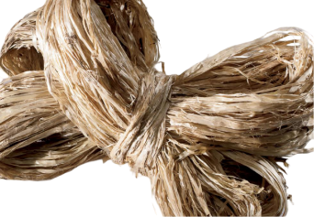
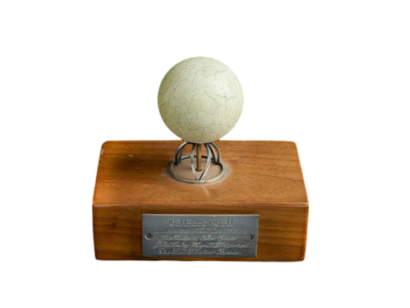
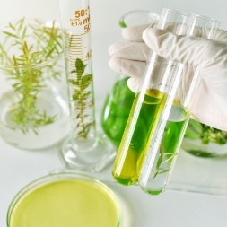
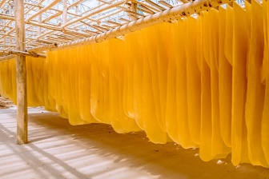
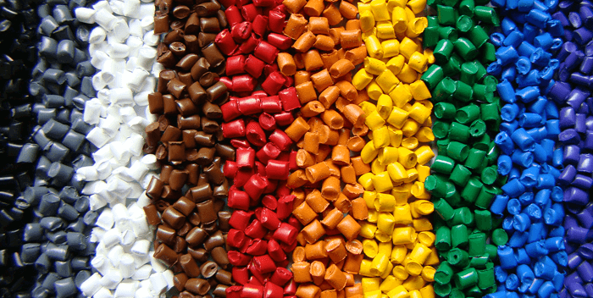
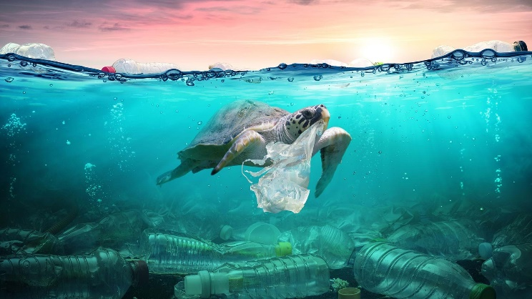
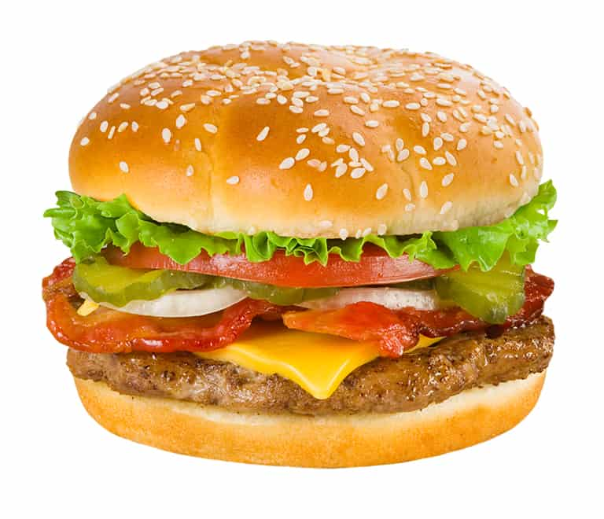
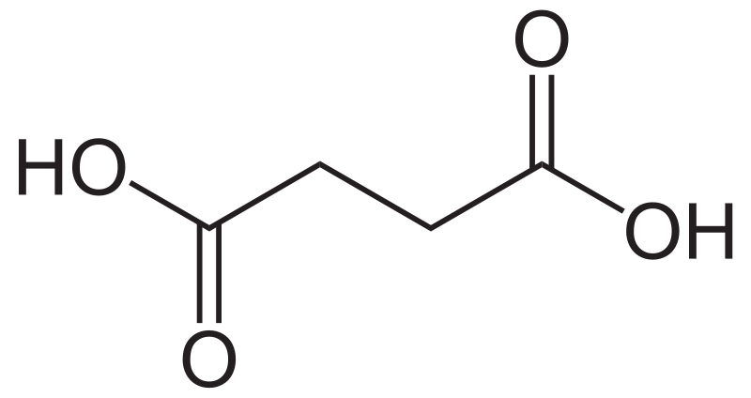
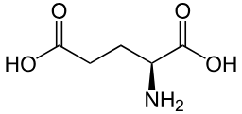
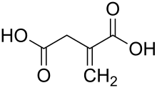
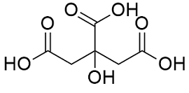
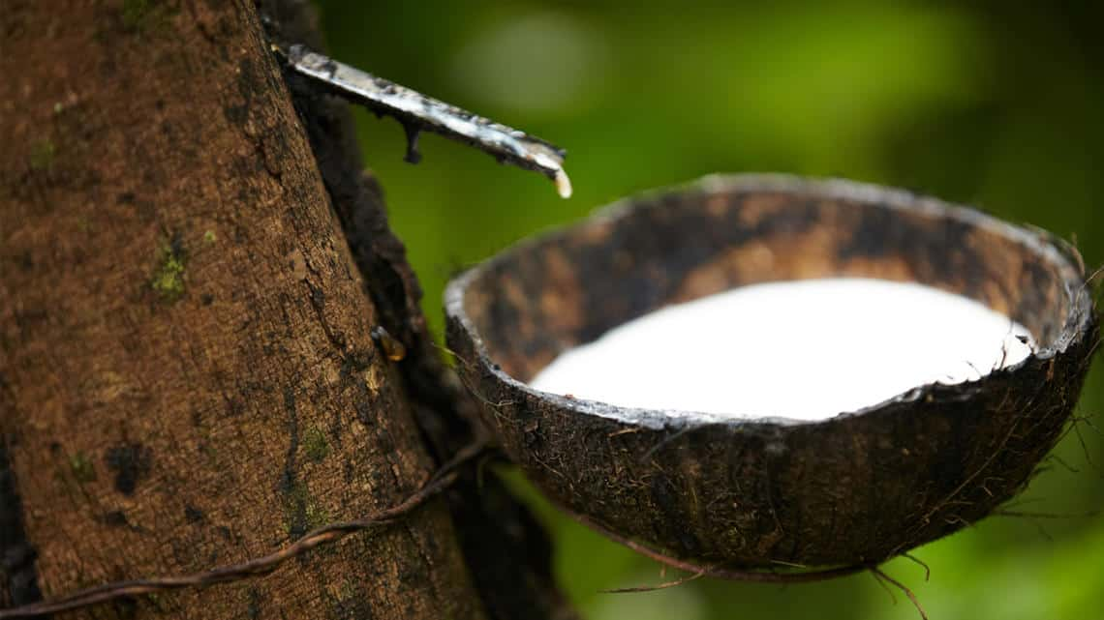
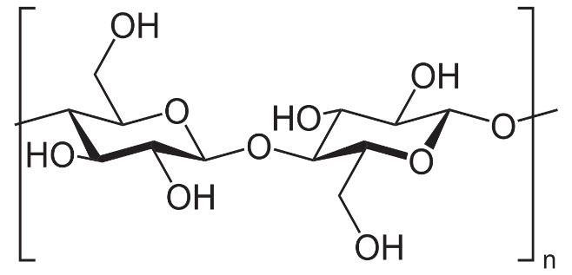
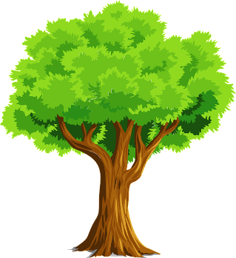
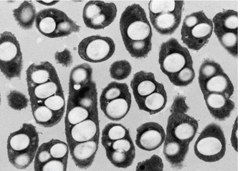
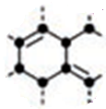
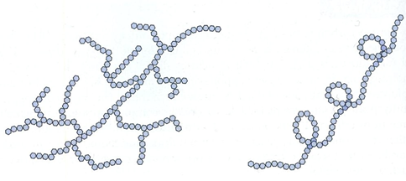
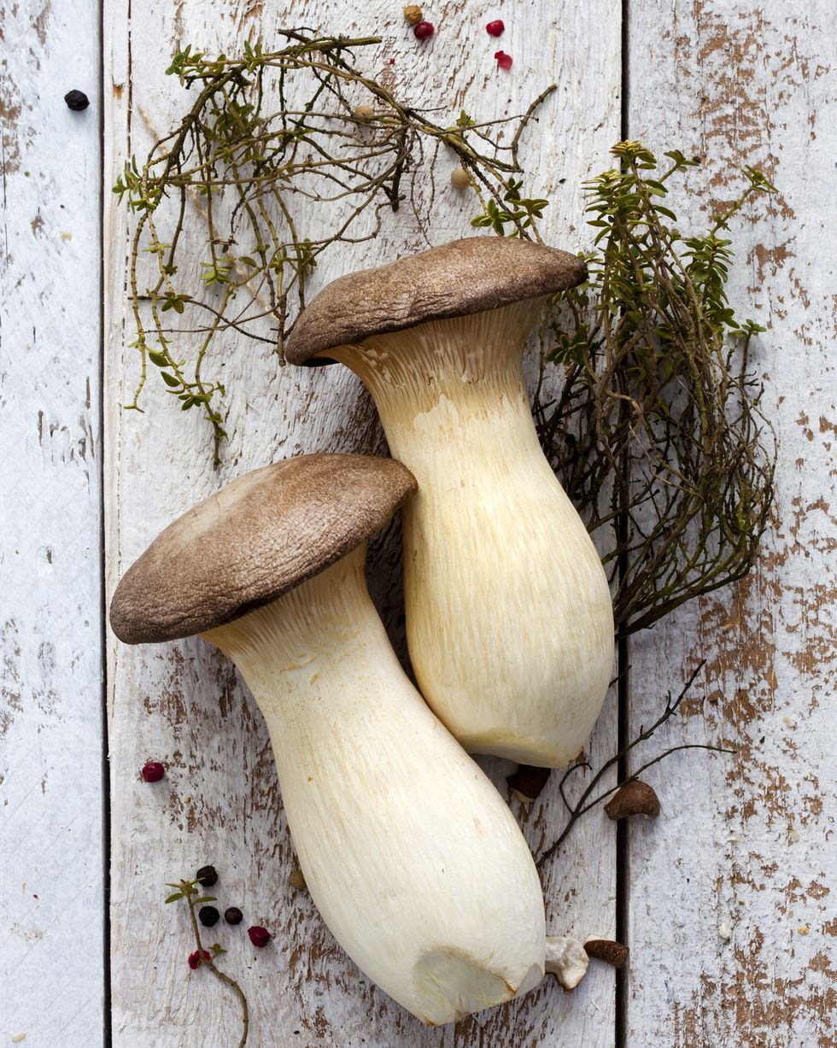
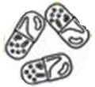
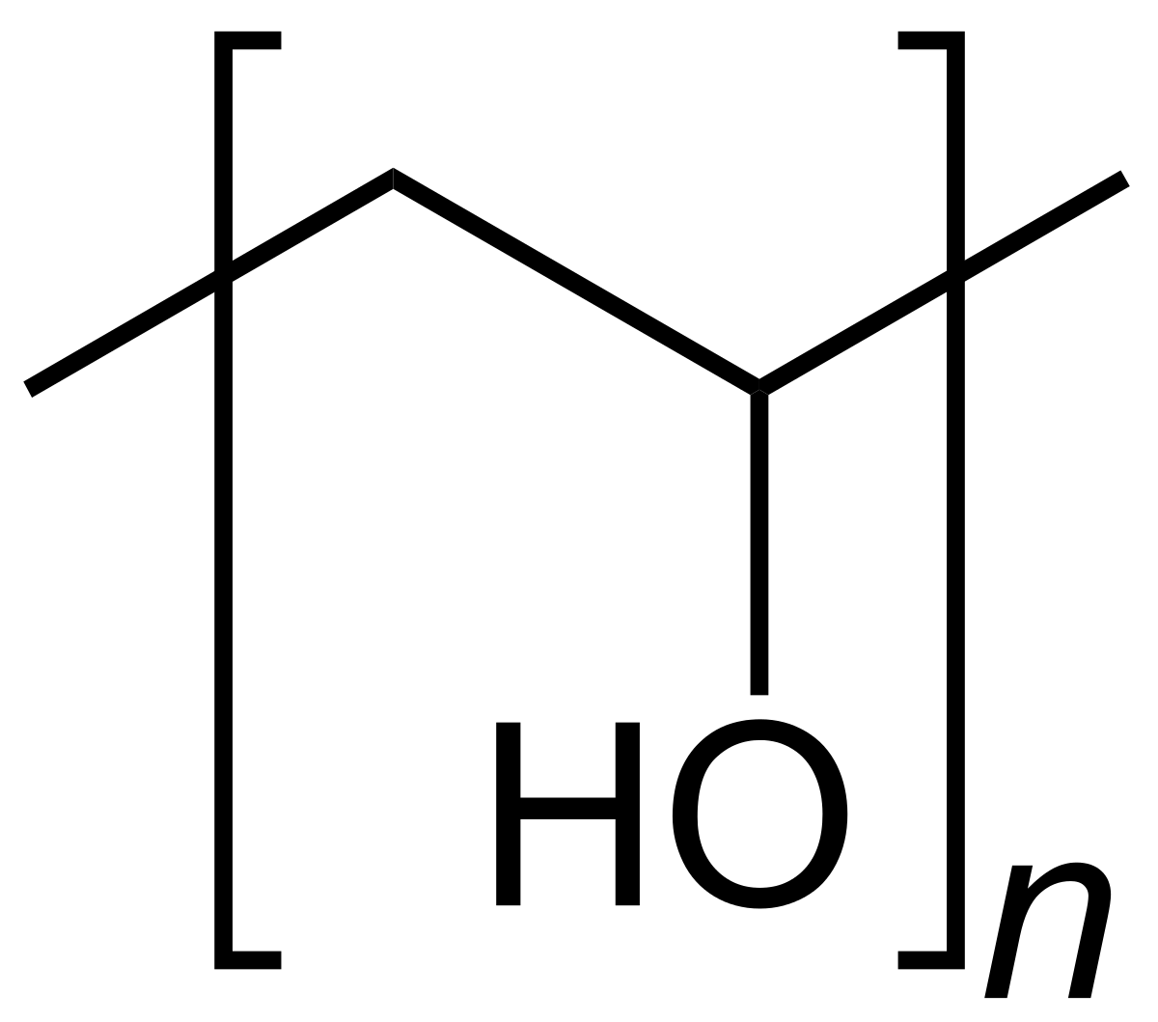
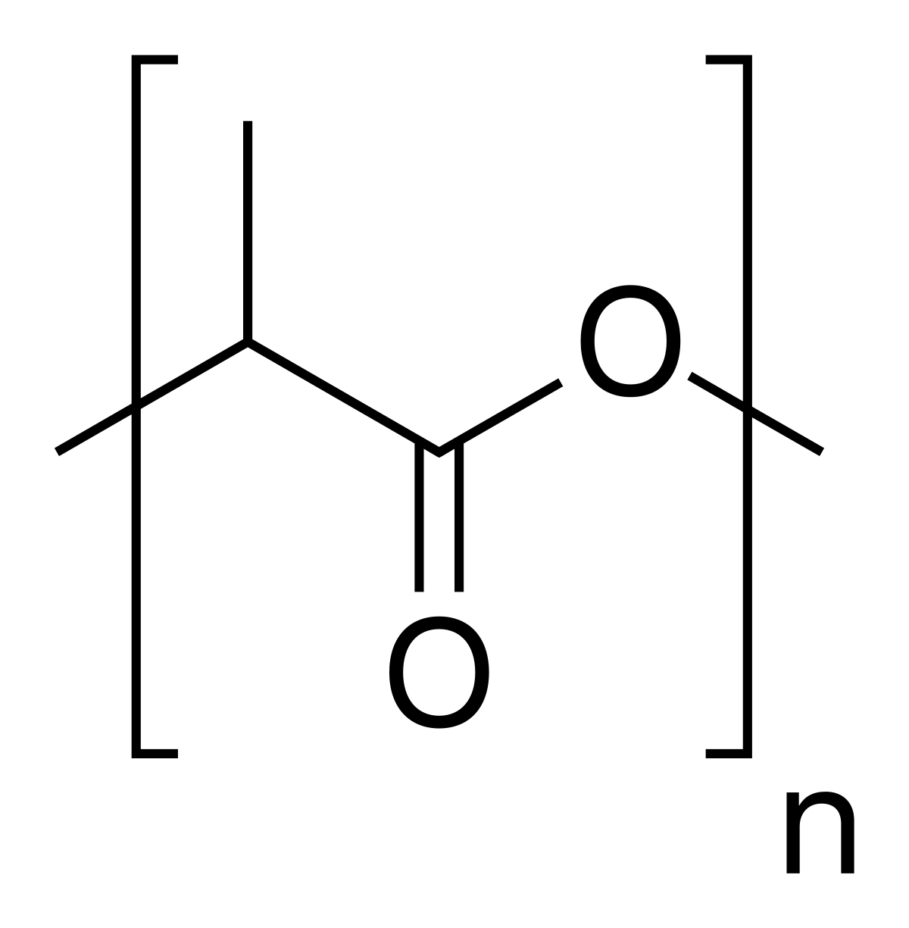
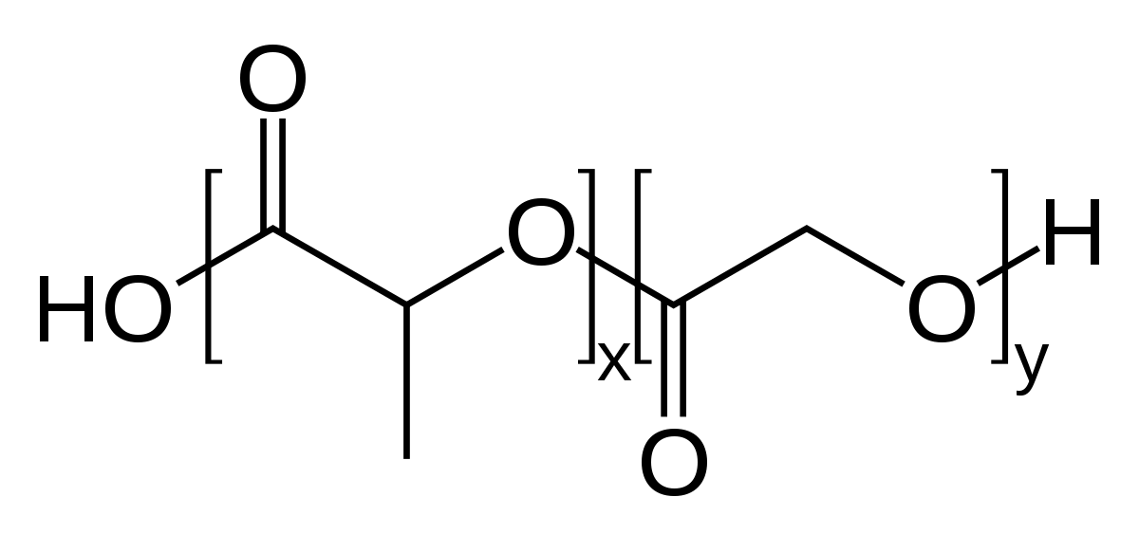
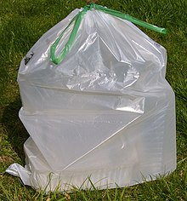
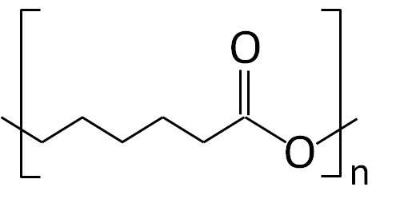
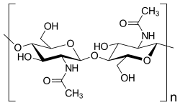
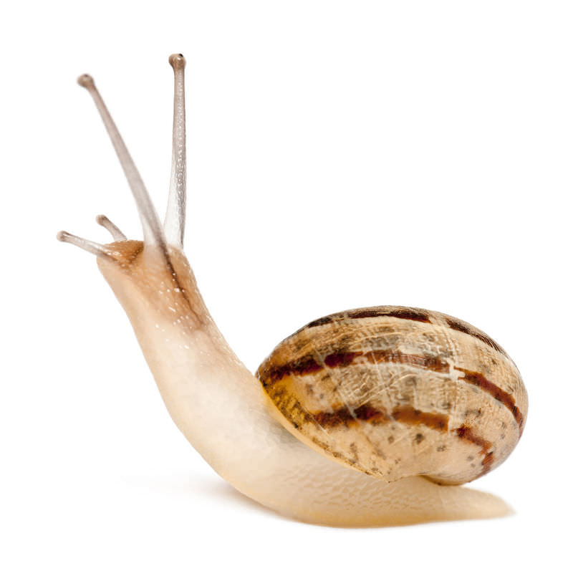
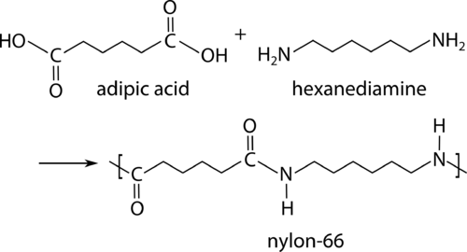
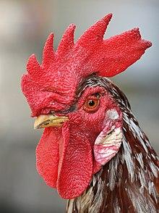
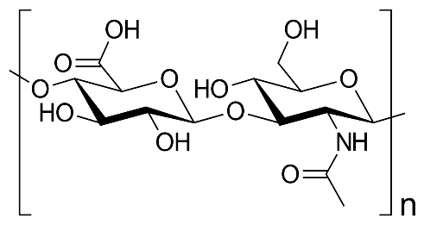
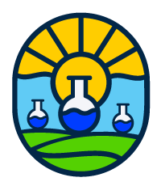
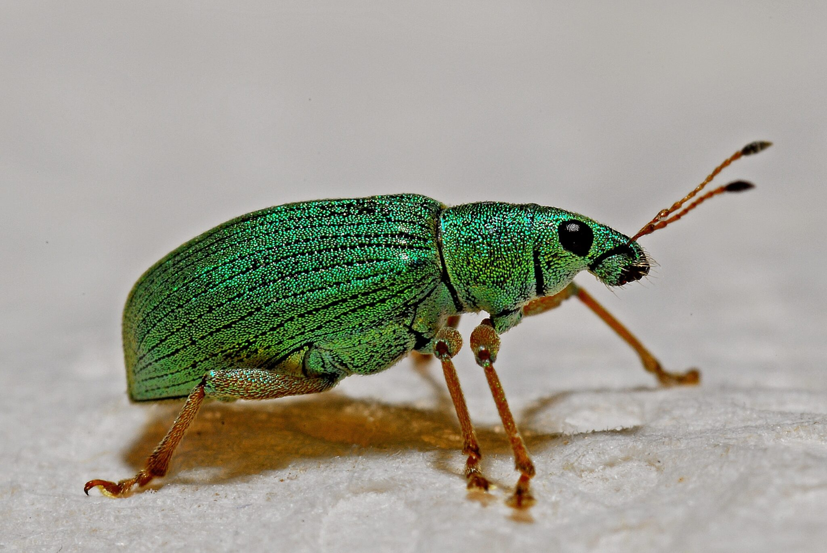
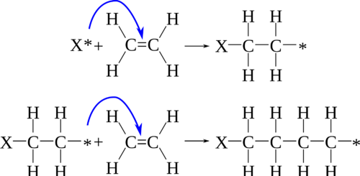
Natural Polymers: Paving the Way for Sustainable Materials
History, Development and Applications
The Green and Sustainable Grand Scheme
Green Principles
The Evolution of Materials: From Natural to Synthetic and Green
From prehistoric wool fibers to the isolation of natural rubber for recreational use by the Aztecs, natural polymers have been widely used throughout human history. It wasn’t until the 1800-1900s when chemists began reinventing natural polymers and developing synthetic alternatives. In the mid 1900s, such fast developments initiated the plastic and composite movement eventually inspiring the discipline of polymer science. Synthetic fibers, rubbers, plastics and resins began expanding markets, igniting unlimited potential in applications and industries. Unfortunately, this also started the plastic pandemic - a movement where plastic waste dominates a majority of the world’s waste streams with minimal reprocessing. The future of polymers is found in the past - natural polymers. Innovating and inspiring the next generation to develop biodegradable and biocompatible plastics that are comparable to their synthetic analogs in every way from performance, strength and durability while being good for the planet, is not economically taxing, and readily accepted by consumers.
Costs and Benefits
Though natural polymers are the key to creating a more sustainable future, this goal cannot be achieved without synthetic means. To have a more green and sustainable future, the synthetic polymer realm must be ready to adopt biobased and biorenewable feedstocks to reduce the dependence on fossil fuels and continue developing and innovating biobased polymers that are biocompatible and biodegradable through enzymatic degradation yielding inert biomass or feedstock generation. Additionally, current industry should continue improving and adopting green and sustainable synthesis into is core by integrating and investing in catalysis, methodologies and scalability. Systematically, a closed loop, circular economy would facilitate improved recyclability and processability of synthetic natural polymers. As with most new consumables in the market, unfortunately the greener polymer market has not found its foundation
Darián Vazquezª , Dylan Shuster^{b}.
a. Institute of Chemistry of Rosario, Department of Organic Chemistry, Faculty of Biochemical and Pharmaceutical Sciences, National University of Rosario, Suipacha 531, S2002LRK, Argentine, vazquez@iquir-conicet.gov.ar
b. University of Massachusetts Lowell, Department of Chemistry, Lowell, MA 01854, United States, dylan_shuster@student.uml.edu
REDUCED DEPENDENCE ON FOSSIL FUELS
BIODEGRADABILITY
First Age
Second Age
Third Age
LOWER CARBON FOOTPRINT
Abstract: The use of polymeric materials from renewable resources has a long history, with naturally occurring polymers being among the first materials used by men. In the 19th century, natural materials, such as casein, natural rubber, and cellulose, were modified to obtain useful polymeric materials. Over the past few decades, the production and application of synthetic polymers have seen an almost exponential increase. However, concerns regarding depletion of fossil resources, disposal and related issues, as well as government policies, have led to a continuously growing interest in the development of sustainable, safe, and environmentally friendly plastics from renewable resources.
Natural Fibers
Natural Rubber
Synthetic Polymers
Plastic Pandemic
Green Polymers
LIMITED SCALABILITY
HIGH INITIAL COSTS
500 AD
1600 AD
1900 AD
1950 AD
2000 AD
Market Readiness
Definition
Synthetic Polymers are Everywhere!
What does it mean to be a “Natural Polymer”?
A “natural” polymer is a naturally occurring material that is synthesized and/or extracted from natural resources without any human intervention. Typically are water-soluble, are better at biodegrading, more biocompatible in nature, and take on the form of polysaccharides (sugars, starch, chitin, etc.), polyesters, polyamides (proteins & polypeptides), and polyanhydrides (nucleic acids).
Cosmetics
Regenerative medicine
and cracked the consumer code for market readiness and implementation, policy, investment and incentivization could always help foster the growth necessary to replace current unsustainable synthetic polymers and aid in the plastic pandemic.
What it is…
Therapeutic
adjuvants
Biomedical
Application Fields
Itaconic Acid
Citric Acid
Succinic Acid
Glutamic Acid
Bio-Based Monomers
Pharmaceutical Industry
Packaging &
Textiles
3D Printing
Sustainable Applications
Edible Films and Food Packaging
Polysaccharides
Lipids
Proteins
Cellulose
Plants
Food
Industry
Drug Delivery Systems
Natural Polymers
Biomedical Coatings and Activity
1
Microbes
PVA
PLA
PLGA
Antiviral
Antibacterial
Antifungal
Antitumor
Drug Carriers
Biofilms
Starch (amylopectin)
Starch (amylose)
Synthetic Routes
PCL
Synthetic Methods
Condensation
Environmentally & Medically Compatible Polymers
Tissue Engineering, Nanomedicine
Natural Rubber, cis-1,4-polyisoprene
Animals
Chitin
When a polymer is formed from two or more monomers with reactive side chain functionalities.
Direct
Indirect
References:
Chitosan
Melt Blending
Chemical Polymerization
[1] Burford, Robert. “Polymers: A Historical Perspective.” Jorn. & Proc. of the Royal Society of New South Wales. 2019. 152: (2). 242-250.
[2] Satchanska, Galina. Davidova, Slavena. Petrov, Petar. “Natural and Synthetic Polymers for Biomedical and Environmental Applications.” Polymers. 2024. 16: (8). 1159.
[3] Thomas, Dan. “Engineering regenerative tissue systems using 3D bioprinting technology. A golden era for reconstructive surgery”. International Journal of Surgery. 2021 64. 325-340.
[4] Avi Domb, Boaz Mizrahi, Shady Farah (2023). “Biomaterials and Biopolymers.” Springer Cham.
[5] Silva, A.C.Q.; Silvestre, A.J.D.; Vilela, C.; Freire, C.S.R. “Natural Polymers-Based Materials: A Contribution to a Greener Future”. Molecules 2022, 27, 94.
Amino Acids, Peptides, Proteins, DNA
Addition
Hyaluronic acid
Physical Mixing
Electro- Polymerization
What it isn’t…
Solution Blending
Photo- Polymerization
When a vinyl, oleic monomer is activated and adds sequentially until terminated.
A Natural Polymer can become Synthetic, but a Synthetic Polymer cannot be Natural.
For example, natural rubber comes from the rubber tree, but once cured during vulcanization, it is no longer considered “natural”, biodegradable, or biocompatible. Alternatively, polymers made from fossil fuels/petroleum-based products are not naturally occurring and are considered synthetic.
Mechano- Polymerization
Variations of addition polymerization: cationic, anionic, free-radical, atom transfer radical polymerization (ATRP), ring-opening polymerization (ROP), nitroxide-mediated radical polymerization (NMP), reversible addition-fragmentation chain transfer (RAFT).

