Slide 1
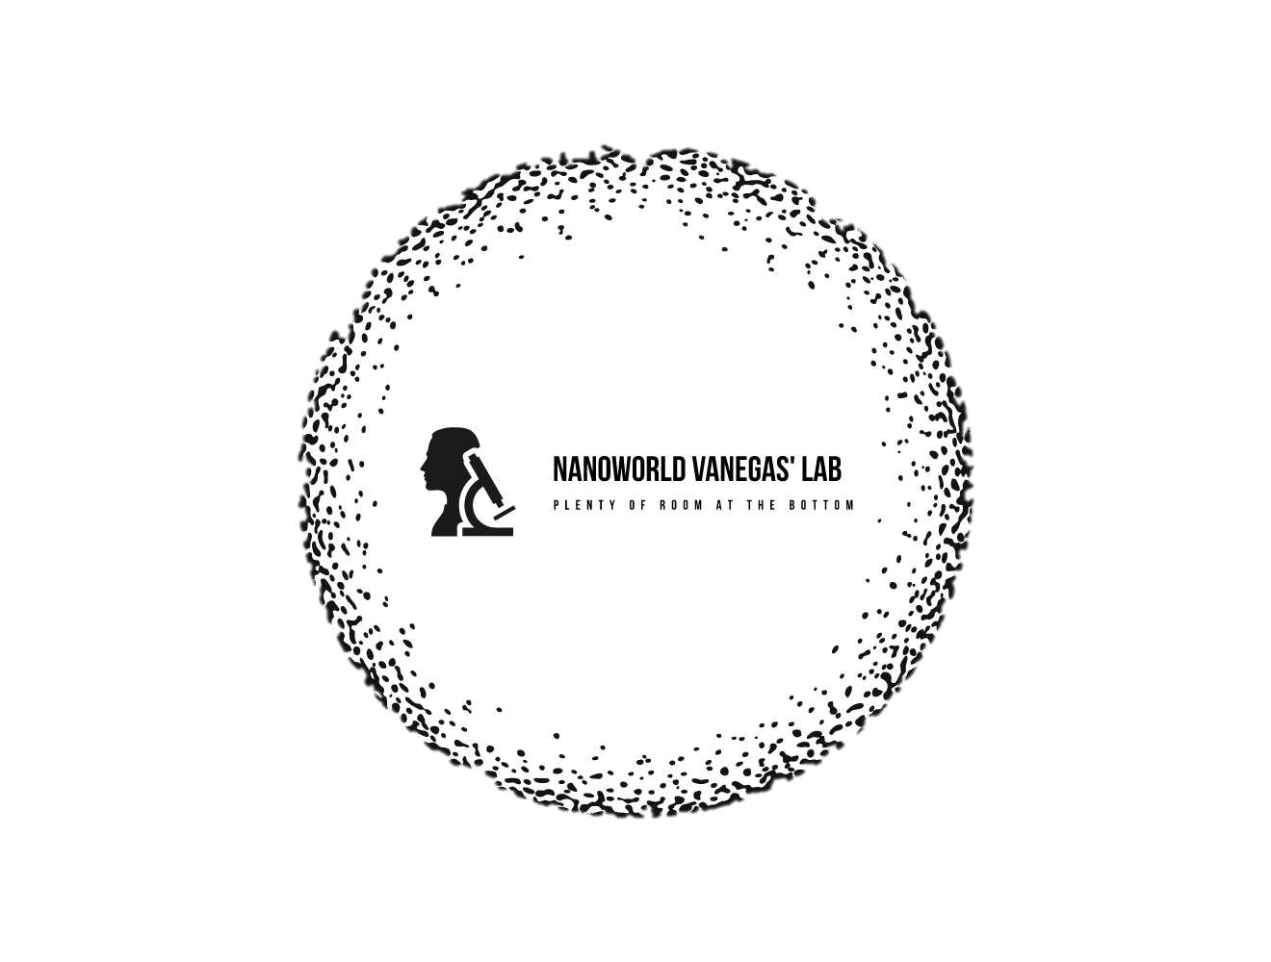

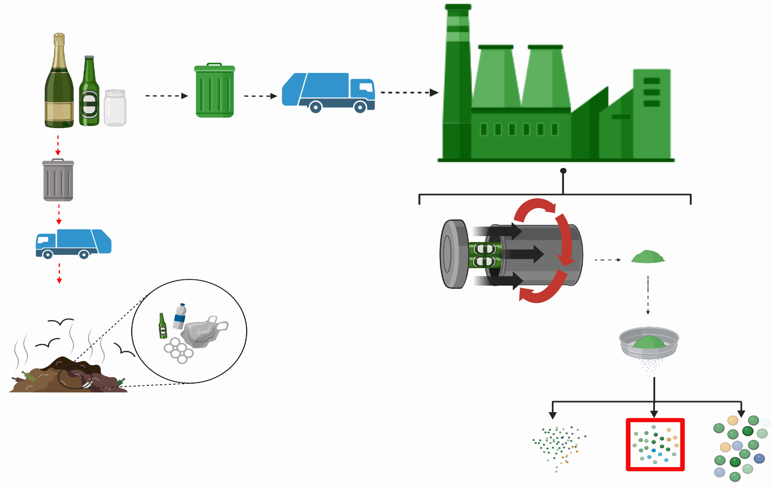
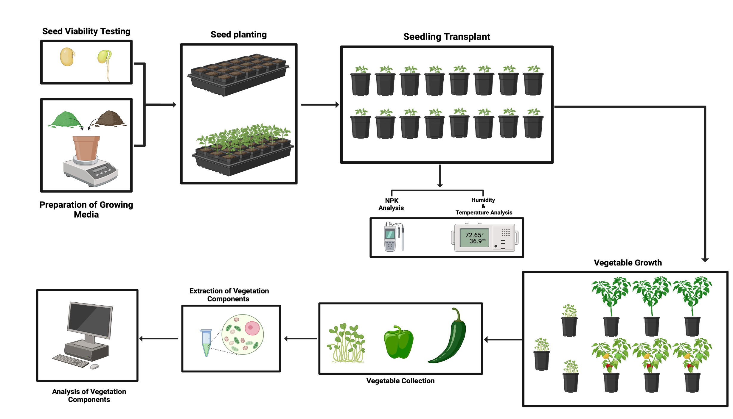
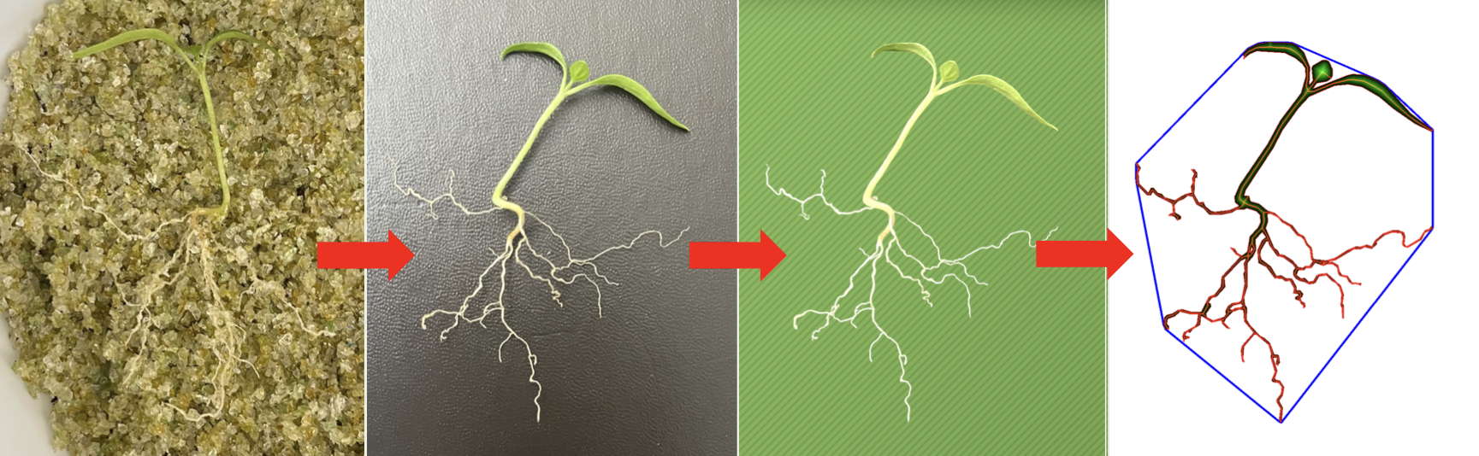
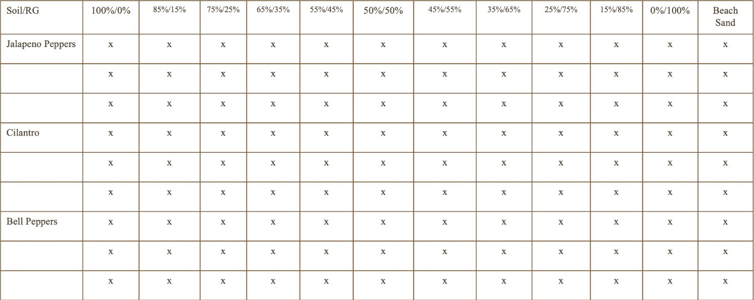
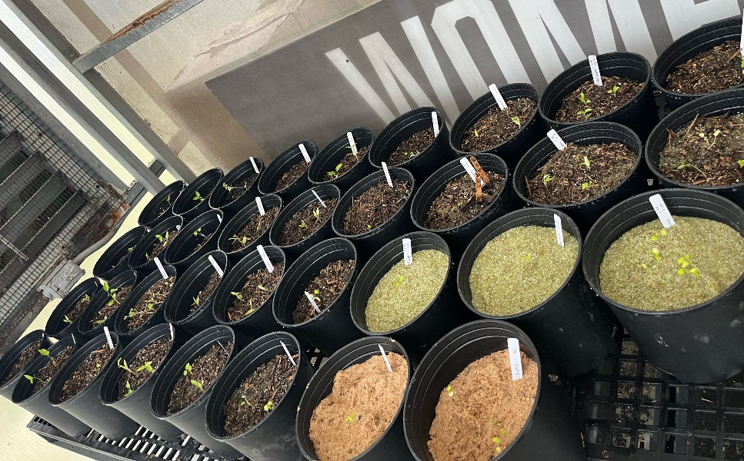

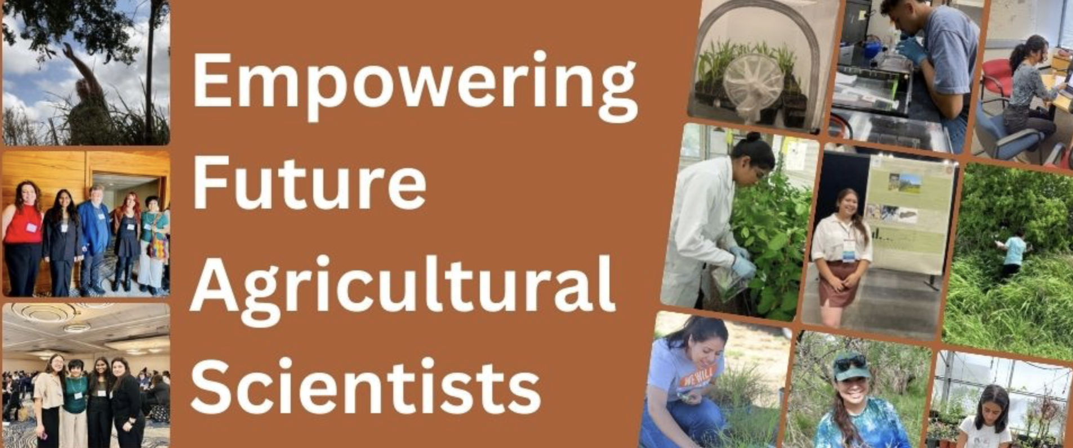
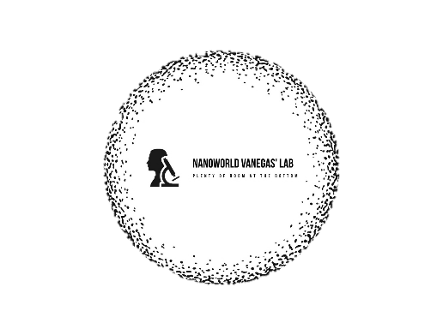
Evaluating Recyclable Glass Material as a Substitute for Soil in Vegetable Cultivation: An Innovative Approach to Sustainable Agriculture
Andres F. Hernandez¹, Teresa P Feria-Arroyo^{*2,} Julie P. Vanegas*³
The University of Texas Rio Grande Valley; School of Integrative Biological and Chemical Sciences^{1,2}
The University of Texas Rio Grande Valley; Department of Physics and Astronomy³
INTRODUCTION
METHODOLOGY
RESULTS AND DISCUSSION
The sustainability of agricultural practices is increasingly critical amid environmental challenges. While effective, traditional soil-based agricultural methods often contribute to soil degradation and resource depletion. The earth’s topsoil has eroded by 50% during the last 150 years. In addition to this, soil has also been affected by agricultural practices. These effects include compaction, loss of soil structure, nutrient degradation, and soil salinity [1]. As a result, this alternative growing media is being explored to reduce environmental impact and promote sustainable agriculture.
One promising alternative is using recycled glass as a substitute for conventional soil. Recycling glass offers multiple benefits, such as reducing landfill waste, supporting a circular economy, offering sustainable manufacturing processes, creating green jobs, and an endless cycle of recyclability [2].This study evaluates the potential of recycled glass as a viable growth medium, either as a partial or complete substitute for conventional soil, by analyzing its effects on plant growth, yield, nutrient retention, overall health, and other factors. By comparing the performance of plants grown in recycled glass material (mixed and as a complete substitute) with those grown in traditional soil, it aims to determine whether this innovative substrate can support proper plant development and serve as a sustainable alternative in agricultural practices.
The utilization of recycled glass material has demonstrated potential as a substitute for conventional soil in the cultivation of edible vegetation. When recycled glass material is processed properly it can be feasible to be introduced into agricultural practices. This study reveals this innovative growing media as viable in generating increased growth rate results, as well as increased plant yield percentages. As shown is Figure 12, the growth rate of cilantro plants growing in mixed media containing more recycled glass material percentages resulted in higher growth rates for this specific vegetation. Figure 13 indicates that mixed media containing from 50:50 soil-to-recycled glass (weight-to-weight) ratio to 100:0 soil-to-recycled glass ratio exhibited almost entirely 100 percent plant yield. In contrast of mixed media with less than 50 percent recycled glass and 100 percent conventional soil which exhibited plant yields lower than 70 percent for the cilantro vegetation. These findings support the potential of recycled glass material as an alternative for conventional soil and exhibits its future importance in sustainable agricultural practices
Figure 13. Graph of Cilantro plant yield showing results for Soil:Recycled glass (weight-to-weight) ratios, 100:0 to 0:100 & beach sand, in respective order.
Figure 3. Overview of the glass processing procedure.
CONCLUSIONS
Vegetation Growth and Analyses Procedure
Analysis
Effectiveness as a Soil Substitute: Our research has provided initial evidence that recyclable glass material can act as a viable alternative to soil for cultivating various vegetable crops.
Proper processing is crucial for this material to act as a viable alternative for conventional soil, either as a complete or partial substitute.
This innovative medium has demonstrated the potential to match traditional soil regarding growth rates.
This innovative medium has demonstrated the potential to exceed the yields typically achieved with conventional soil.
These promising findings suggest that recycled glass could play a pivotal role in sustainable agriculture practices, inspiring a shift towards more eco-friendly farming practices.
Figure 8. Graph of seed viability results for Jalapeno vegetation, using a light table.
ONGOING RESEARCH
Examine the nutrient level of the cultivated vegetables to determine what medium yields higher nutritional value.
2. Determine if substitution of soil for recycled glass material is viable for crop production.
3. Investigate environmental applications of research findings at a local level.
4. Analyzing primary root growth provides insights into the plants' foundational support through the examination of primary root growth, essential for nutrient uptake and overall stability.
5. Investigating the plants' resilience to environmental stressors, a key factor in sustainable agricultural practices.
Figure 4. Schematic procedure for vegetation growth and cultivation.
Figure 9. Graph of seed viability results for Bell Pepper vegetation, using a light table.
Figure 10. Graph of seed viability results for Cilantro vegetation, using germination method.
Figure 1. Preparation procedure for root analysis after vegetation cultivation using RhizoVisionExplorer software.
Figure 2. Minirhizotron tool built to determine correct size for recycled glass material utilized in vegetable cultivation.
REFERENCES
Table 1. Soil-to-recycled glass (weight-to-weight) ratios.
Figure 5. Picture of results after transplanting seedlings
[1] World Wildlife Fund. (n.d.). https://www.worldwildlife.org/threats/soil-erosion-and-degradation
[2] Insulation, K. (2021, March 18). How glass recycling helps the planet. Knauf Insulation North America. https://www.knaufnorthamerica.com/en-us/blog/how-glass-recycling-helps-the-planet
[3] Recycle for the Coast. (n.d.). Materials. Recycle for the Coast. https://recycleforthecoast.org/materials
[4] P. J. White, P. H. Brown (2010), Plant nutrition for sustainable development and global health, Annals of Botany, Volume 105, Issue 7, June 2010, Pages 1073–1080, https://doi.org/10.1093/aob/mcq085
[5] ​Baldermann, S., Blagojević, L., Frede, K., Klopsch, R., Neugart, S., Neumann, A., Ngwene, B. ... Schreiner, M. (2016). ​Are Neglected Plants the Food for the Future? Critical Reviews in Plant Sciences, 35(2), ​106​-119​. ​doi: https://doi.org/10.1080/07352689.2016.1201399
OBJECTIVES AND HYPOTHESIS
Figure 11. Comparative graph of N, P, K levels in soil media showing results for soil : recycled glass (weight-to-weight) ratios, 100:0 to 0:100 & beach sand, in respective order.
To assess the feasibility, performance, plant growth efficacy, and safety of recycled glass material as an alternative (coexistent or a complete replacement) for conventional soil in vegetation cultivation.
To analyze plant-specific outcomes, including growth rate, nutrient content, and contamination levels, in vegetables grown in recycled glass mediums.
To evaluate the presence and growth of microorganisms and fungi cultivation media containing recycled glass.
Hypothesis
"Recyclable glass material, when processed into a suitable form, can serve as an effective substitute for soil in vegetable cultivation, leading to comparable or improved plant growth and yield while simultaneously reducing pest infestations, landfill accumulation, and water consumption in vegetable cultivation"
Figure 6. Picture of seed starters after 1 week of seed planting; from soil : recycled glass (weight-to-weight) ratio, 100:0 to 0:100, and beach sand, in respective order.
ACKNOWLEDGEMENTS
This work was supported by the National Science Foundation Convergence Accelerator Program through Award #2230769.
This work is supported by Empowering Future Agricultural Scientists: food security and climate change research experiences for undergraduate students. EFAS-REEU, grant no. 2016-67032- 25013, from the USDA National Institute of Food and Agriculture.
Figure 7. Picture of seed starters 5 weeks after seed planting; from soil : recycled glass (weight-to-weight) ratio, 100:0 to 0:100, and beach sand, in respective order.
Figure 12. Comparative graph of Cilantro growth rate over a 3-week course showing results for Soil:Recycled glass (weight-to-weight) ratios, 100:0 to 0:100 & beach sand, in respective order.

