Slide 1
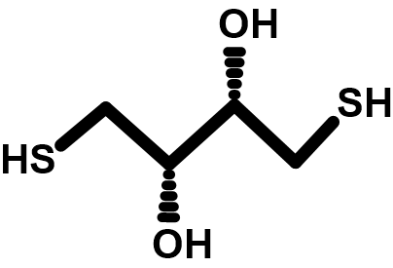
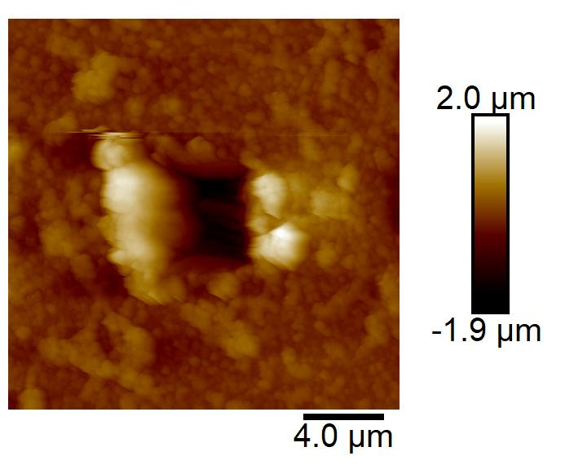
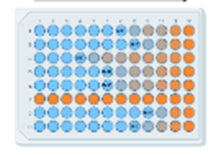
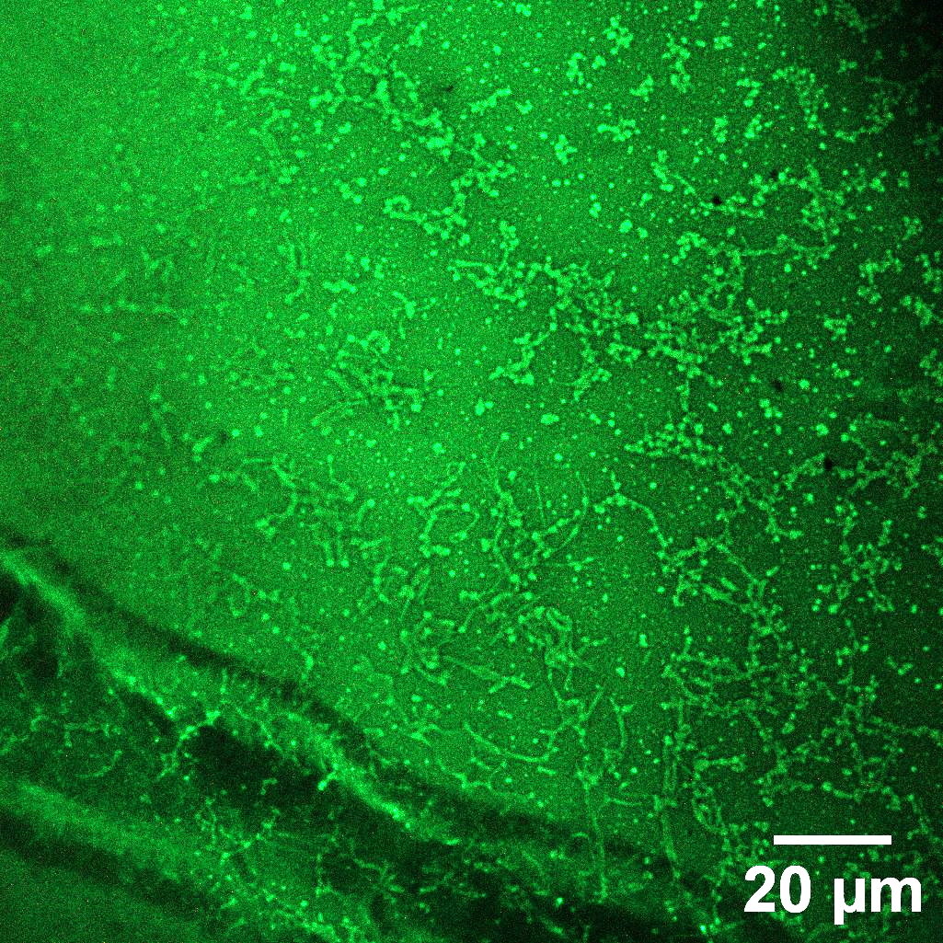
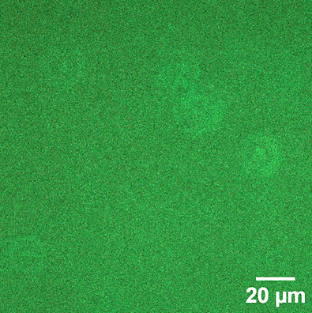
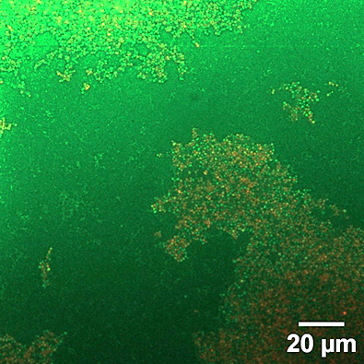
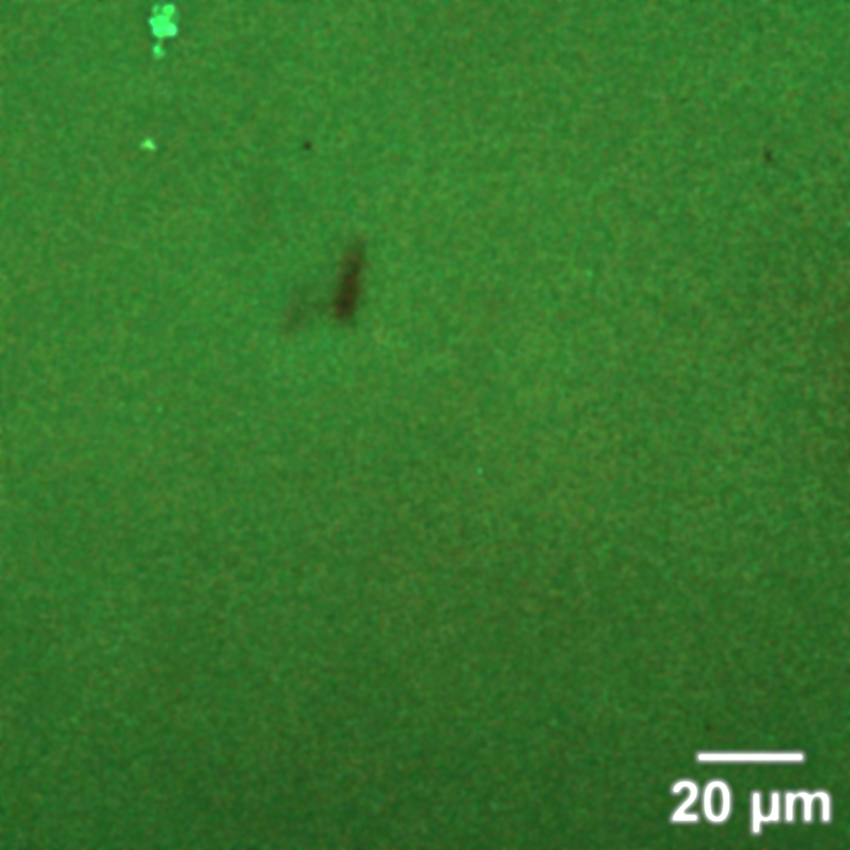
NEXT-GENERATION ANTIMICROBIAL COATING FOR MEDICAL DEVICES BASED ON AMYLOID AGGREGATES: A STEP TOWARD REDUCING PATHOGENIC WASTE
*Calibio Ivon¹, Ghilini Fiorela¹ , Prieto Eduardo ¹, Diaz Carolina ^{1,2} and Schilardi Patricia.¹
. ⁽¹⁾ Instituto de Investigaciones Fisicoquímicas Teóricas y Aplicadas (INIFTA), Facultad de Ciencias Exactas, UNLP- CONICET, La Plata, Bs. As., Argentina. ⁽²⁾ Max Planck Institute for Medical Research, Germany.
*email: ivoncgiraldo@inifta.unlp.edu.ar
2. EXPERIMENTAL
INTRODUCTION.
Infections associated with medical devices are a serious global issue, affecting millions of patients and increasing healthcare costs (1). These infections are primarily due to the formation of biofilms on the surfaces of devices such as catheters and implants, which act as protective barriers against antimicrobial treatments and compromise device functionality. Additionally, infections in indwelling devices contribute to environmental pollution due to the frequent need for replacements, further increasing the burden on healthcare system. This study presents an antimicrobial and biocompatible coating made from amyloid aggregates of bovine serum albumin (BSA) on glass and PVC (Polyvinyl Chloride), designed to inhibit the adhesion of Staphylococcus aureus (S.A), a common pathogen in medical device infections.(2) The addition of vancomycin on adhered bacteria on the coating enhances the antimicrobial effect, offering a sustainable solution rooted in green chemistry principles. BSA, as a natural and renewable protein, reduces reliance on synthetic materials, aligning this approach with environmentally friendly and sustainable practices.
The BSA amyloid-like aggregates were prepared by mixing BSA and dithiothreitol (DTT) solutions. Then, the PVC or glass samples were immersed in the aggregates solution. The characterization was carried out by AFM, confocal microscopy, FTIR spectrophotometry and contact angle measurements.
4°C
4°C
Hela Cel
Biofilm cycle
40 min
Ditiotreitol
(DTT)
40 min
AMYLOID
AGGREGATE
SOLUTION
UNCOATED
SAMPLES
+
VANCOMYCIN
4° C
AGGREGATES- COATED SAMPLES
37°C 6 h
3. RESULTS AND DISCUSSION
.
3.4 SURFACE CHARACTERIZATION BY ATOMIC FORCE MICROSCOPY (AFM)
AND CONTACT ANGLE MEASUREMENTS
3.1 FLUORESENCE INTENSITY ASSAYS.
(A) PVC
(B) PVC +FILM
(C) GLASS
(D) GLASS +FILM
The amyloid-like structure of the aggregates was confirmed by fluorescence spectrophotometry by adding thioflavin T (ThT) to the aggregates on PVC surfaces. ThT binds to the channels parallel to the long axis of the amyloids aggregates, giving rise to its characteristic emission fluorescence peak around 485 nm upon excitation at 450 nm.
(A)
1.6 µm
(B)
(C)
202.2 nm
SURFACE ROUGHNESS.
Sample | Roughness (nm)
(A) UNCOATED PVC | 4.4 ± 0.9 nm
(B) PVC + FILM | 6.35 ± 1.0 nm
(C) UNCOATED GLASS | 0.34 ± 0.4 nm
(D) GLASS + FILM | 1.67 ± 0.1
3.2 FTIR ASSAY
.
PVC + FILM
GLASS + FILM
The FTIR spectra show a change in the structure of BSA, evidenced by a shift in the amide I' band from 1650 cm⁻¹( ), representative of alpha helices, to 1634 cm⁻¹ ( ), and characteristic of beta-sheets.
FILM THICKNESS MEASUREMENT BY SCRATCHING USING AFM
3.5 ANTIMICROBIAL ACTIVITY
Staphylococcus
aureus (*)
SESSILE POPULATION
PLANKTONIC POPULATION
3.3 CITOTOXITY ASSAY
The coatings do not affect the growth of HeLa cells exposed to the surfaces in the control well.
Incubation at 37°C
for 2 hours
(A)
(B)
≈ 0.312 µg/mL
of vancomycin
adhesion
PVC Uncoated
PVC+Film
Proliferation
PVC+Film
Minimum Inhibitory
Concentration (MIC) assay
PVC Uncoated
4. CONCLUSIONS
LIVE/DEAD ASSAY FOR STAPHYLOCOCCUS AUREUS: 2H ADHESION (A), AND 24 H PROLIFRRATION (B)
Films of amyloid aggregates were successfully prepared on PVC and glass surfaces.
The coating has anti-biofouling effect, decreasing the number of adhered bacteria with respect to both, PVC and glass uncoated surfaces. The combined effect of the film and the antibiotic treatment results in bacterial eradication.
The films have a good biocompatibility on HeLa cells.
These results indicate that the coatings have potential applications in medical devices that are susceptible to bacterial colonization, such as endotracheal tubes, urinary catheter, etc.
This innovative coating, characterized by its antimicrobial activity, biocompatibility, and broad applicability to medical devices, helps reduce nosocomial infections and the generation of pathogenic environmental waste. Additionally, it minimizes the need to dispose of medical devices that would otherwise require replacement once an infection occurs.
5. BIBLIOGRAPHY
Assefa, M., & Amare, A. (2022). Biofilm-Associated multi-drug resistance in hospital-acquired infections: a review. Infection and Drug Resistance, 5061-5068.
Tran, N. N., Morrisette, T., Jorgensen, S. C., Orench‐Benvenutti, J. M., & Kebriaei, R. (2023). Current therapies and challenges for the treatment of Staphylococcus aureus biofilm‐related infections. Pharmacotherapy: The Journal of Human Pharmacology and Drug Therapy.
6. ACKNOWLEDGEMENTS
Universidad Nacional de La Plata (UNLP). CONICET and Agencia I+D+i, Argentine, and Max Planck Institute for Medical Research, Germany. IYCG acknowledges the scholarship from CONICET

