Slide 1
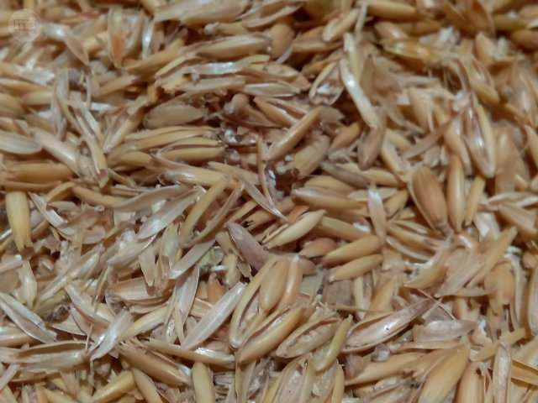
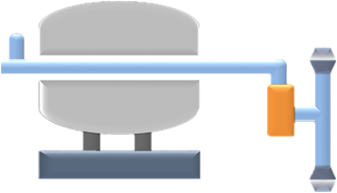
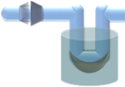
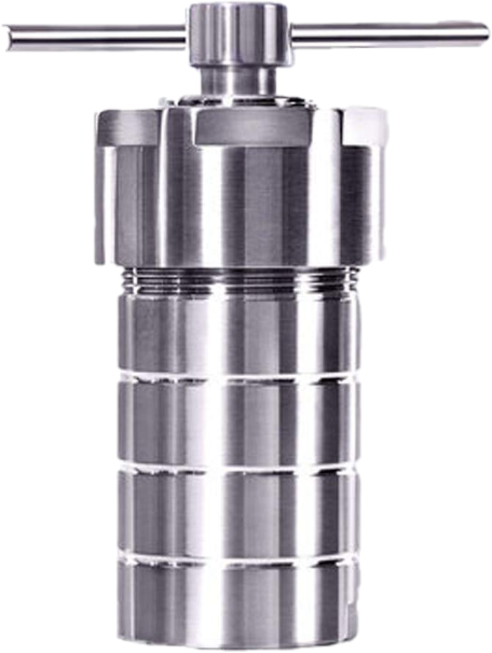
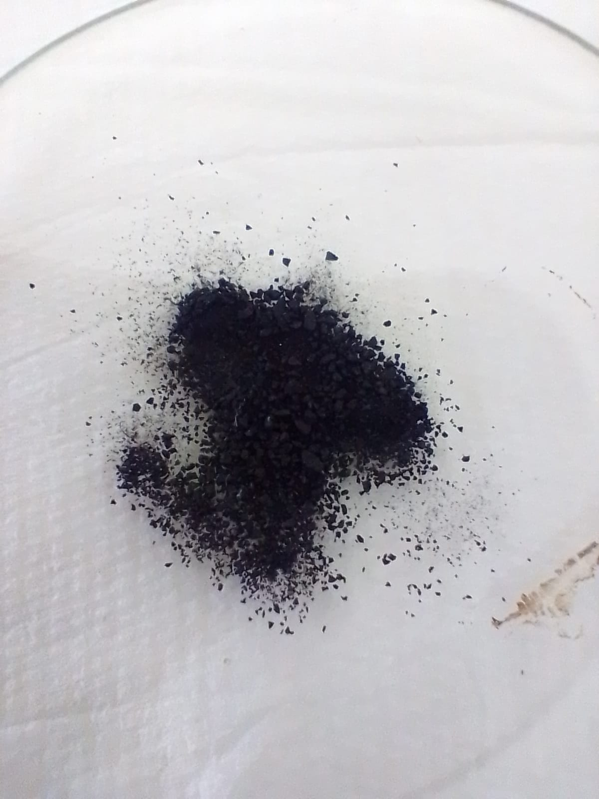
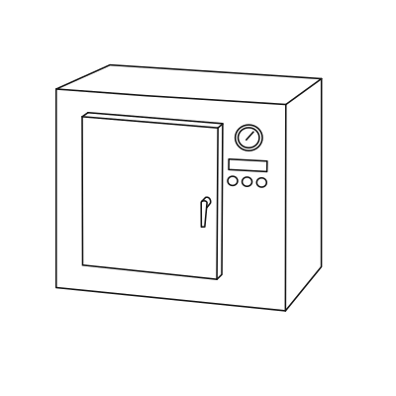
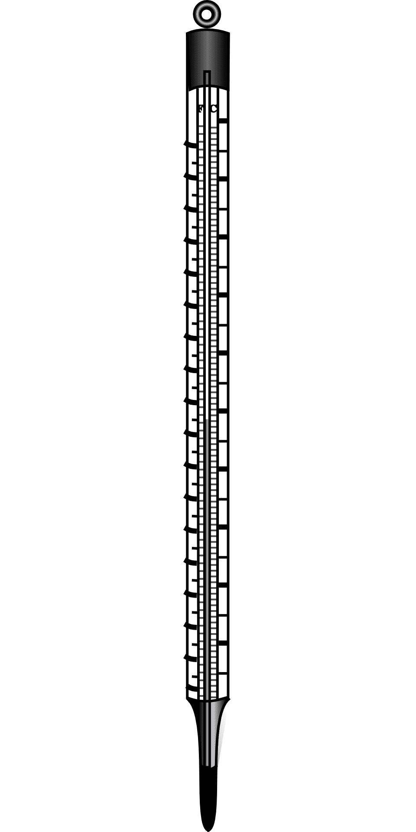
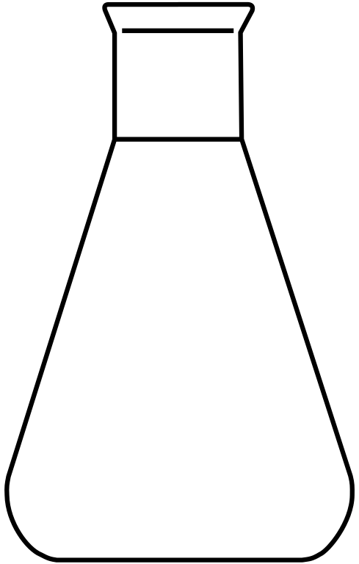
Biochar-Polymer Composites for Enhanced Adsorption of Contaminant Ions
Débora A. López ^{1*}
¹ Departamento de Fisicoquímica, Instituto de Investigaciones en Fisicoquímica de Córdoba (INFIQC), CONICET, Universidad Nacional de Córdoba, Facultad de Ciencias Químicas, Medina Allende y Haya de la Torre, 5000, Córdoba, Argentina. *dlopez@unc.edu.ar
INTRODUCTION
OBJECTIVES
In recent times, traditional methods of agro-industrial waste management, such as burning and burial, have become inappropriate and ineffective due to the associated problems of water, air and soil pollution. In Argentina, the rice industry produces large quantities of rice husk (RH) as waste and its management is currently not regulated. This project proposes the thermal transformation of this waste by rapid pyrolysis to obtain biochar (BC) that can be used as a platform for the synthesis of composites with chitosan (CH) and tested for metal ions adsorption from aqueous solutions.
Prepare and characterize pyrolytic carbons derived from residual rice husk.
Develop and characterize biocarbon composites by combining pyrolytic carbons with cost-effective and readily available biopolymers derived from polysaccharides.
Evaluate the adsorption capacity of biochars and composites for metal ions in aqueous solutions, and optimize the adsorption conditions.
PYROLYSIS OF RICE HUSK
Fast pyrolysis experiments (Fig. 1) were carried out for 20 min, with a constant flow of nitrogen gas (carrier gas) of 0.1 mL/s and pressure between 1-5 torr. The temperatures studied were 300, 400 and 500°C. After each experiment, the solid and liquid fractions—key pyrolytic products—were collected, and their respective yields were determined.
Rice husk
Vacuum gauge
Furnace
Fig. 2. Fraction yields of products at different temperatures
Vacuum
pump
Flowmeter
Figure 2 depicts the variation of the liquid (bio-oil), solid (biochar) and gaseous (pyrolysis gas) fractions as a function of pyrolysis temperature. Despite of the temperature of the experiments, the gaseous fraction resulted the main product reaching its highest at 500°C. Biochar yield was found to be also significant at lower temper-
Trap
T°
ACTIVITIES AND METHODOLOGY
atures. Bio-oil yield ranged from 13 to 27% w/w. Pyrolysis at 400°C resulted as maximum biochar and biooil leading to a less gas
Carrier
gas
residue production condition when comparing with production at 300 and 500°C.
Fig. 1. Fast pyrolysis equipment
ADSORPTION EXPERIMENTS
COMPOSITE SYNTHESIS
0.45g BC
CH-BC
2h
1
The adsorption of Cr (VI) was tested using the
biochar obtained at 400°C and under the
response surface methodology. Fig. 3 shows the
step-by-step procedure: first, the biochar was washed and dried in an oven. Then, the different adsorption experiments were carried out varying temperature, biochar dosage and pH at an initial Cr (VI) concentration of 50 mg/L for 1 h. Finally, the solid was separated from the supernatant, and the residual Cr(VI) concentration in the solution was measured using UV-Visible spectrophotometry.
1.05g Solid CH
CH₃COOH 2%
50mL 60°C
20mL NaOH 2M
12h
140°C
Sol. CH
2
Fig. 4. Chitosan- biochar (CH-BC) composite synthesis.
The composite (CH-BC) was synthesized using a recently developed hydrothermal method* in which chitosan was first dissolved in a 2% w/w acetic acid solution for 40 min. RH biochar was then incorporated into the solution and the mixture was stirred for an additional 30 min. Next, sodium hydroxide was added to the mixture, which was then allowed to react for 2 hours. The reaction mixture was transferred to a hydrothermal reactor and heated at 140°C for 12 hours. Finally, the resulting black solid (Fig. 4) was characterized
3
Fig. 3. Adsorption procedure
*J. Song et al. Water Reas. 2021, 194, 116930
ACKNOWLEDGEMENTS
The authors thanks the Secretariat of Science and Technology of the National University of Córdoba (SECyT-UNC) for funding. The internal postdoctoral fellowship awarded by CONICET is also gratefully acknowledged.

