Slide 1
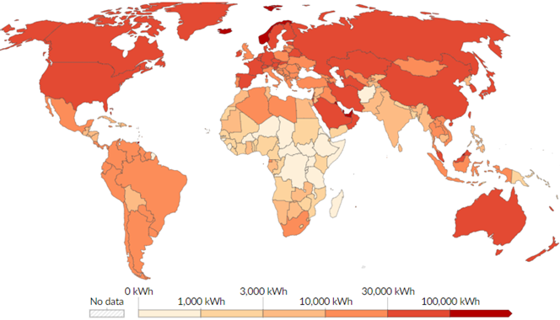
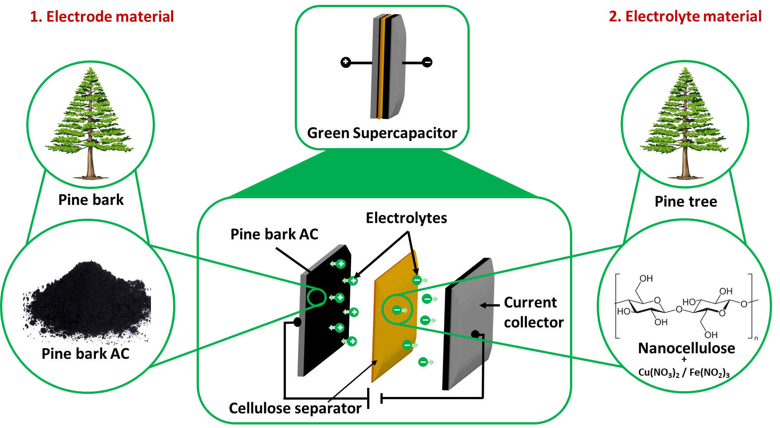
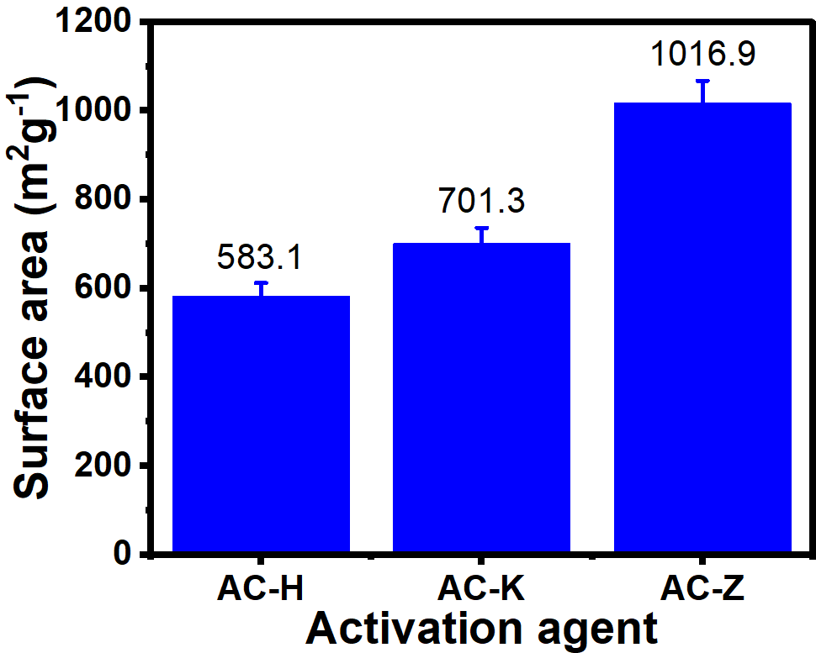
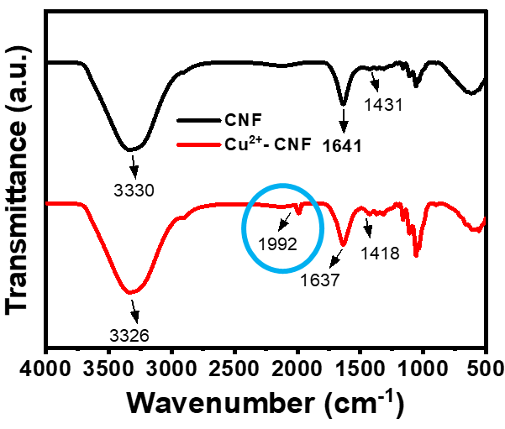
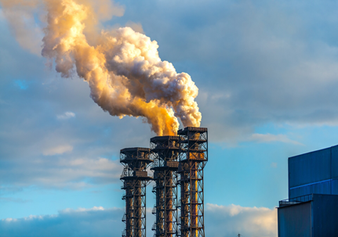
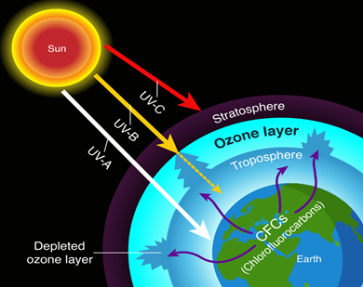
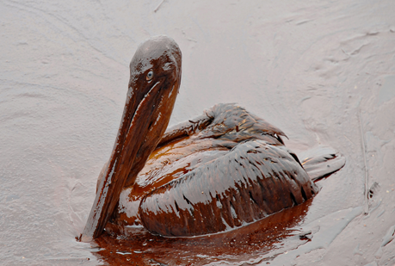
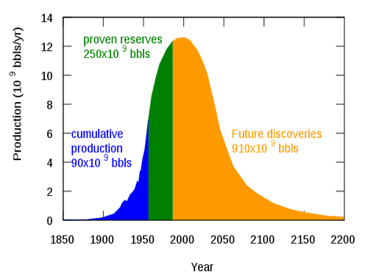
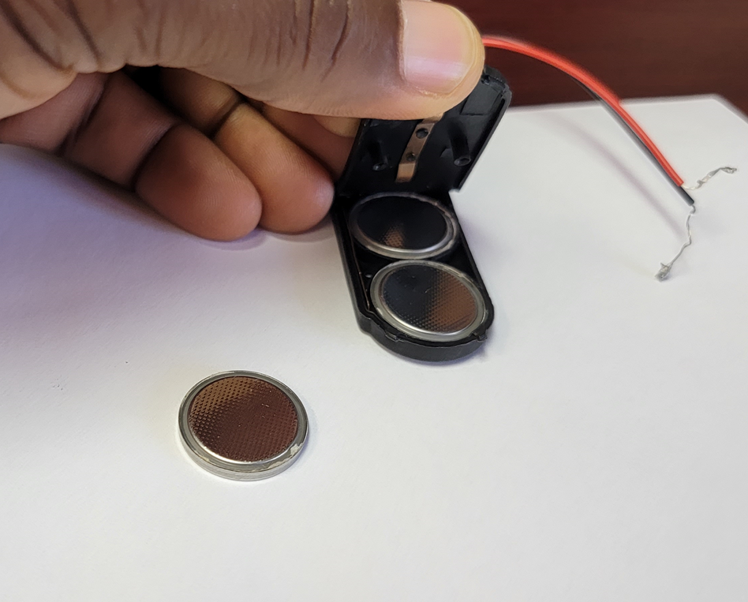
Biomass-Derived Electrode and Electrolyte for Sustainable Solid-State Supercapacitor
Ridwan T. Ayinla, Islam Elsayed, El Barbary Hassan
2025 ACS GCI Green & Sustainable Chemistry Summer School, Burlington, VT, USA
Introduction
Novelty
Material characterization
1. Electrode
2. Electrolyte
BET Surface area
FTIR spectra
Figure 5: BET Surface area and FTIR spectra
Figure 1: World energy use per person in 2023
Figure 3: Novelty and scientific model
Battery characterization
Exponential increase in the world energy demand
Heavy reliance on fossil fuel
Methodology
Electrode material synthesis
Challenges of fossil fuel
Electrolyte material synthesis
Carbon dioxide
Ozone layer depletion
Figure 6: CV, GCD, EIS, and Stability test
Figure 4: Step-by-step experimental approach
Future work
Prototype images of batteries
1. Lab scale prototype design
2. Design flexible batteries
3. Life cycle analysis
References and Acknowledgment
Oil spillage
Fossil fuel depletion
Chem. Rev. 2023, 118 (6), 3121–3207
Nat Rev Chem 2022 (6), 681–704
Figure 2: Problems of fossil fuel
Stand-alone cell
Coin cell batteries

