Slide 1
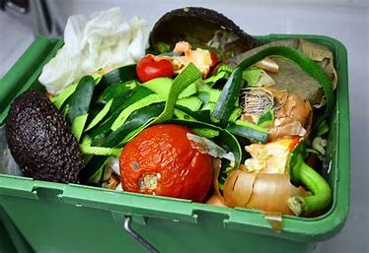
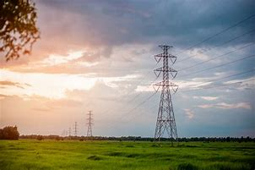
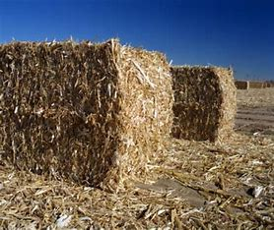
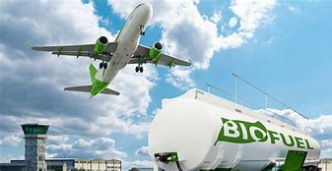
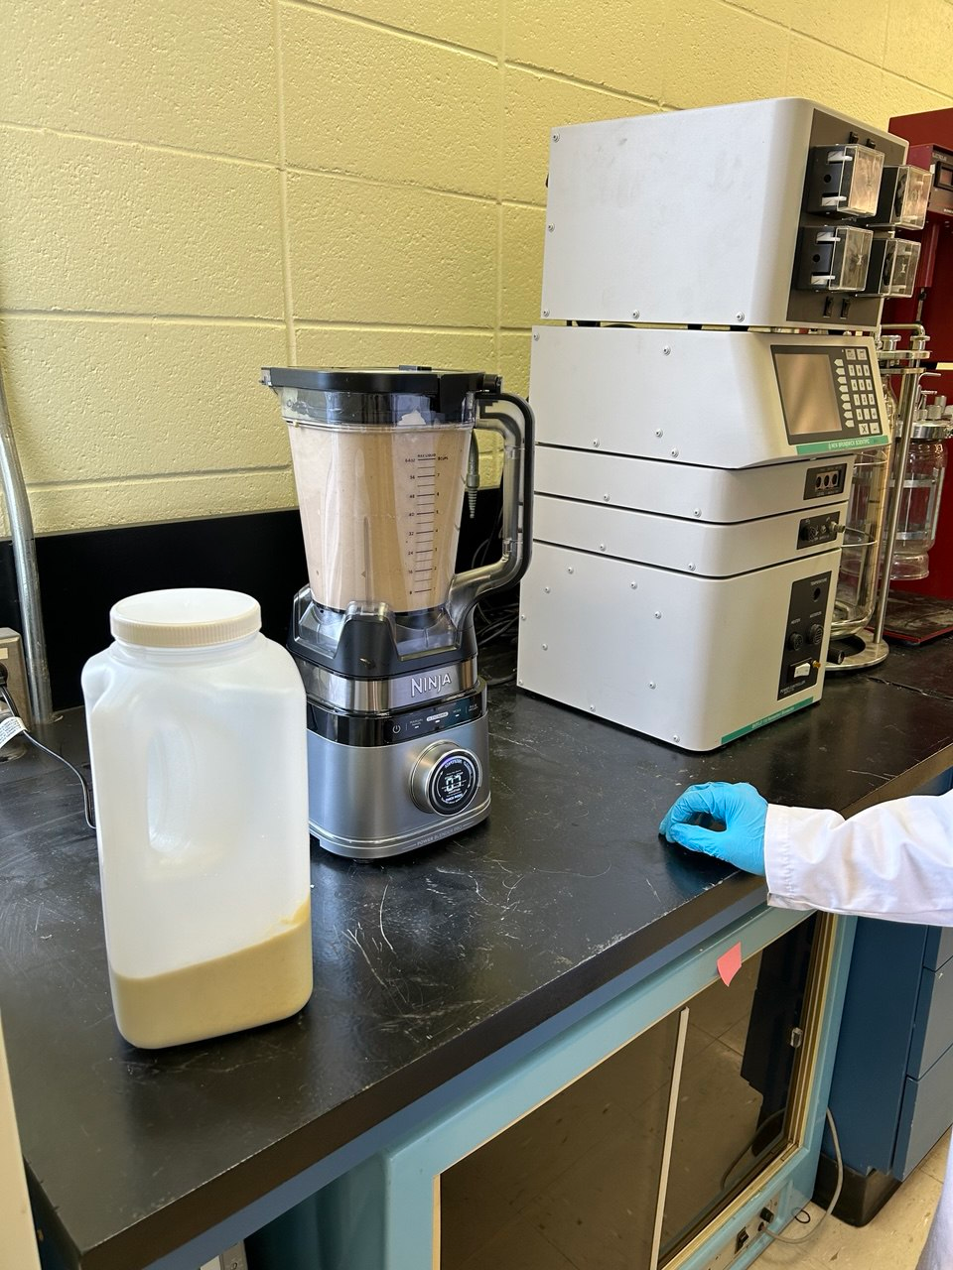
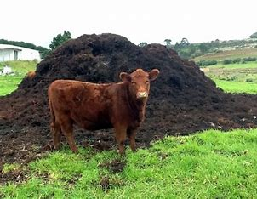
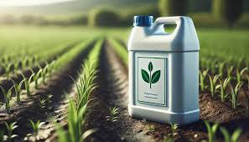
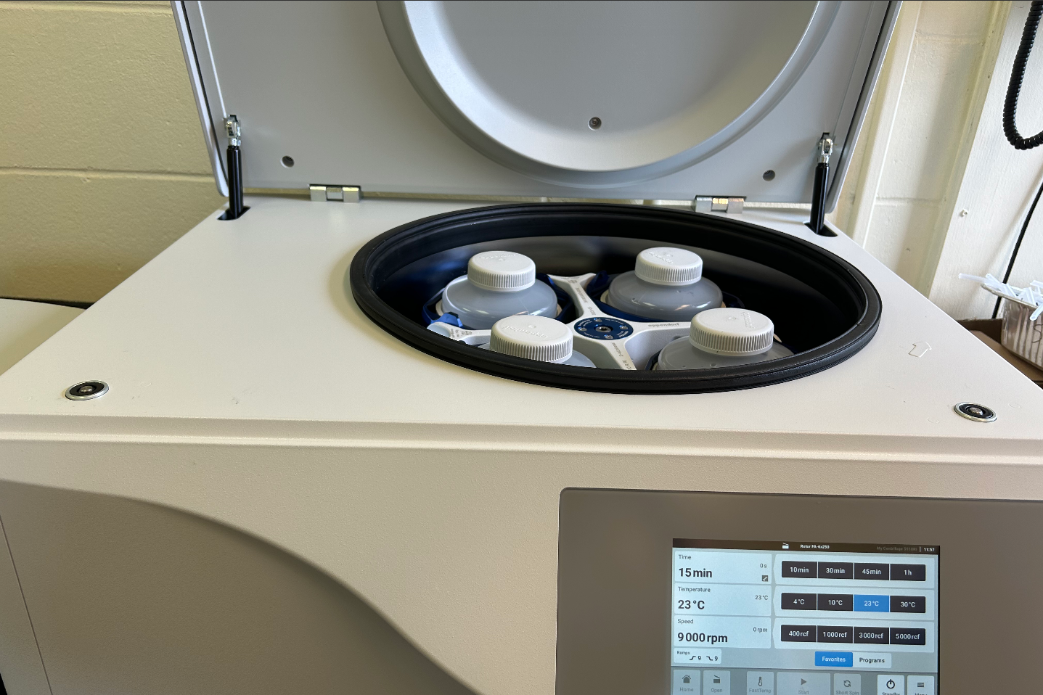
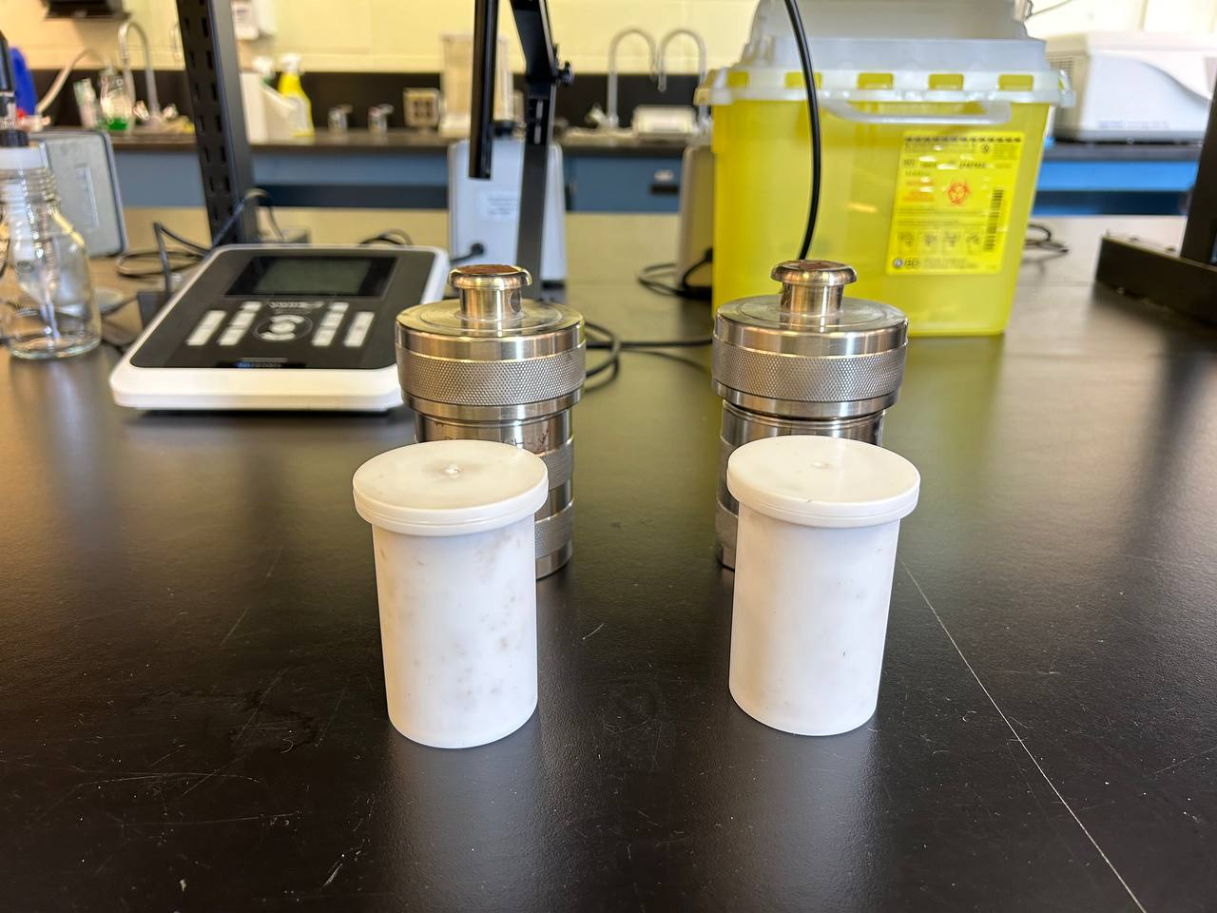
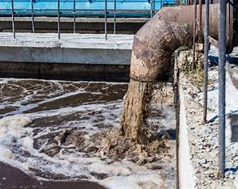
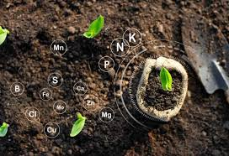
Organic wastes treatment and bioenergy recovery from biomass through anaerobic digestion
Fatemeh Sadat Arghavan¹, Louise Meunier¹, Ehssan Koupaie^{1*}
¹ Department of Chemical Engineering, Smith Engineering, Queen’s University, Canada.
Biomass as a renewable source of energy
Organic material either burned directly to generate energy or converted to liquid and gaseous fuels.
Different ways of converting biomass to bioenergy [1]:
Direct combustion to heat generation
Thermochemical conversion to produce solid, gaseous, and liquid fuels
Chemical conversion to produce liquid fuels
Biological conversion to produce liquid and gaseous fuels
Combination of two or more techniques
Preprocessing techniques on feedstocks
Breaking down complex compounds and making them easily accessible to microorganisms.
Advantages of applying pretreatment on feedstocks before anaerobic digestion [5]:
Increasing the soluble organic fractions: Making them more digestible by microorganisms
Reducing particles size: Increasing surface area and improving biodegradability
Increasing digestate dewaterability: Reducing post-treatment costs
Reducing pathogen: Improving digestate hygienic quality
Sewage sludge
Rupture of sludge flocs
Cell lysis
Crops
Pretreatment
Pretreatment
Wood
Oils and fats
Photosynthesis equation
Cell wall
Cell membrane
6$H_{2}O+6{CO}_{2}$ + radiant energy $C_{6}H_{12}O_{6} + 6O_{2}$
Animal manure
Garbage
Cytoplasm
Sewage
Fig 3. Disruption of sludge floc structure during pretreatment techniques. Sludge flocs consist of microbial cell aggregates encapsulated by extracellular polymeric substances (EPS), which provide structural stability and protection. Pretreatment techniques disrupt this stable structure, breaking down the EPS and releasing intracellular compounds into the surrounding matrix, thereby enhancing the bioavailability of organic materials [5].
Fig 1. Biomass sources for energy production. Plants capture sunlight and convert it into chemical energy stored as carbohydrates through photosynthesis. Various types of biomass, rich in organic compounds, serve as renewable energy sources where the stored energy can be efficiently recovered for sustainable applications [2].
Anaerobic digestion
Biochemical process that converts organic material into valuable products under no oxygen conditions [3].
Lab-scale project
Anaerobic co-digestion (AnCoD) of food waste (FW) and thermal pretreated sludge (TH).
Objectives:
Investigation of the effect of mixing ratios of FW and TH on AnCoD performance
Investigation of the performance of AnCoD in removing chemical oxygen demand (COD)
Investigation of the effect of thermal hydrolysis on sludge degradability
Biogas
Electricity
Food waste
Methanogenesis {4}
Organic waste or feedstocks sources
Acetogenesis {3}
Vehicle fuel
Agricultural residues
Pre-processing
Acidogenesis {2}
Animal manure
Hydrolysis {1}
Digestate
Liquid fertilizer
Sewage sludge
Soil amendment
Fig 4. Schematic of process for setting up co-digestion reactor. Raw sludge collected from a wastewater treatment plant was centrifuged and then thermally pretreated at 170°C for 3 hours using hydrothermal autoclave reactors. Food waste, prepared in the laboratory, was homogenized using a food processor. The two prepared feedstocks were then combined in different mixing ratios.
Fig 2. Organic wastes conversion to valuable bioproducts through anaerobic digestion process. Organic wastes, either alone or combined with other feedstocks, undergo preprocessing to enhance bioavailability before entering the AD system. Microorganisms degrade and convert these materials into biogas. The remaining digestate is another valuable bioproduct of the process, widely used in the agriculture sector.
Key results
Increasing methane yield by incorporating higher proportions of FW into the feedstock mixture.
Achieving the lowest COD removal efficiency (42%) with 100% TH, while 100% FW shows the highest removal efficiency (86 %).
Four phases of anaerobic digestion [4]:
Hydrolysis: Conversion of complex biopolymers to simple monomers
Acidogenesis: Conversion of simple molecules generated in hydrolysis to volatile fatty acids
Acetogenesis: Conversion of volatile fatty acids to acetate, hydrogen, and carbon dioxide
Methanogenesis: Conversion of acetate, carbon dioxide, and hydrogen to methane gas
Green chemistry
Designing products and processes in a way to reduce waste, save energy, and minimize hazardous substances
Relation to green chemistry
Reduction in greenhouse gas emissions Capturing and combusting methane
Diverting organic wastes from landfilling and incineration
Carbon sequestration Applying nutrient rich digestate to the land
Reduction in fossil fuel consumption Generation of renewable heat, electricity and fuel
Fig 5. COD removal efficiency and cumulative methane yield for various mixing ratios of TH and FW.
Conclusion
Enhancing methane yield and COD removal efficiency by mixing sludge with food waste in anaerobic digestion process.
Future directions
Using biochar as a sustainable additive to enhance anaerobic digestion performance.
Applying photocatalytic process as a low-energy alternative to sludge thermal pretreatment.
References
[1] Capareda, S., Introduction to biomass energy conversions. 2023: CRC press.
[2] U.S. Energy Information Administration. (n.d.). Biomass explained. Retrieved January 1, 2025, from https://www.eia.gov/energyexplained/biomass/
[3] Wei, L., et al., Anaerobic Digestion Process and Biogas Production, in Biogas Plants. 2024. p. 1-35.
[4] Vasiliadou, I.A., K. Gioulounta, and K. Stamatelatou, Chapter 9 - Production of biogas via anaerobic digestion, in Handbook of Biofuels Production (Third Edition), R. Luque, et al., Editors. 2023, Woodhead Publishing. p. 253-311.
[5] Mitraka, G.-C., et al., A Comprehensive Review on Pretreatment Methods for Enhanced Biogas Production from Sewage Sludge. Energies, 2022. 15(18): p. 6536.

