Slide 1
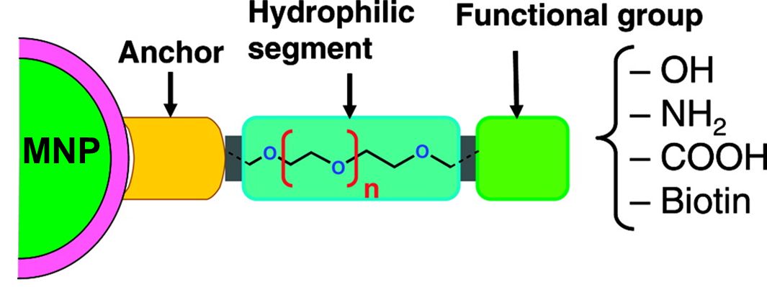
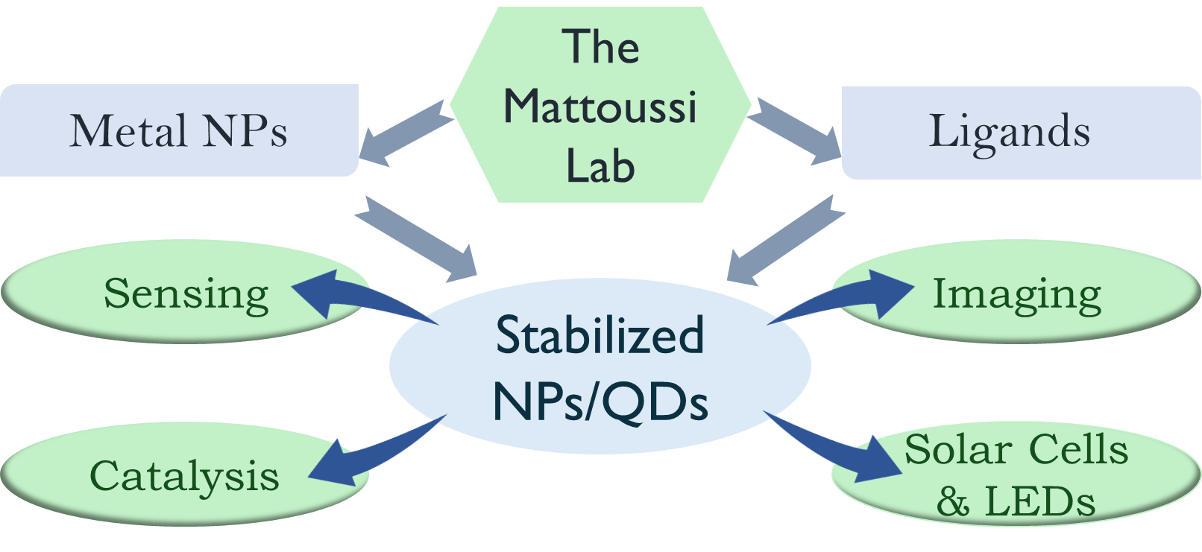
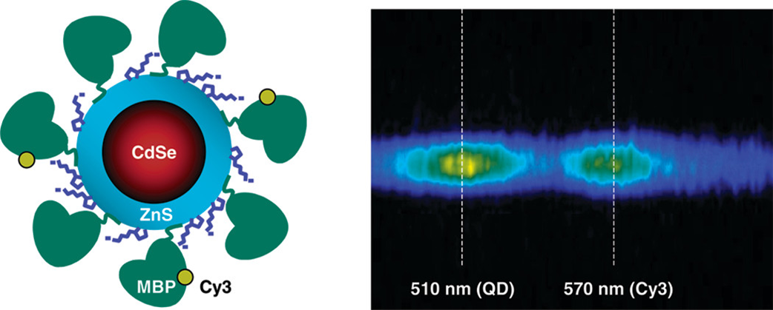
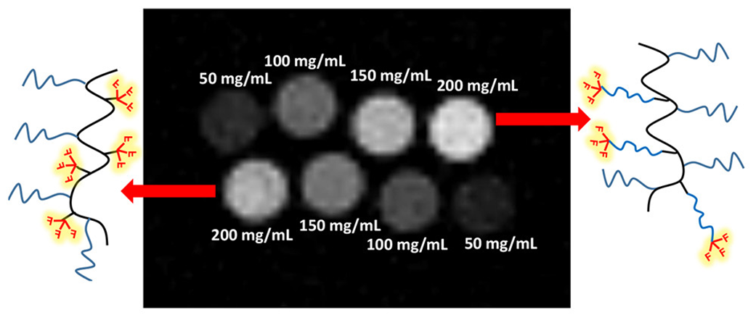
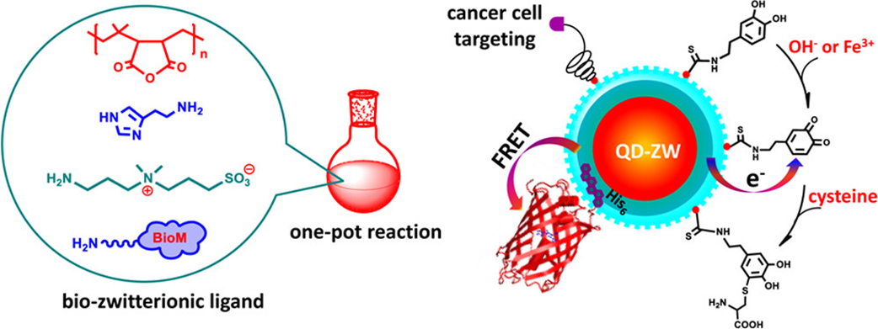
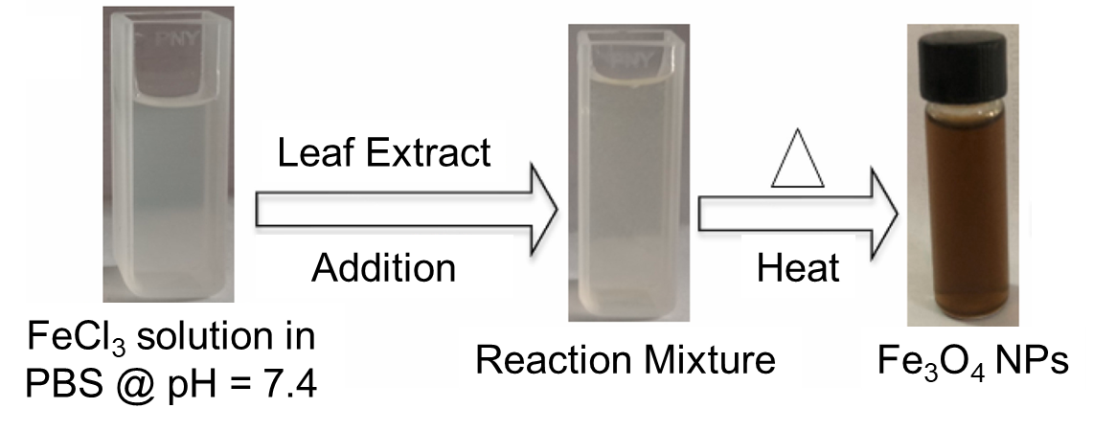
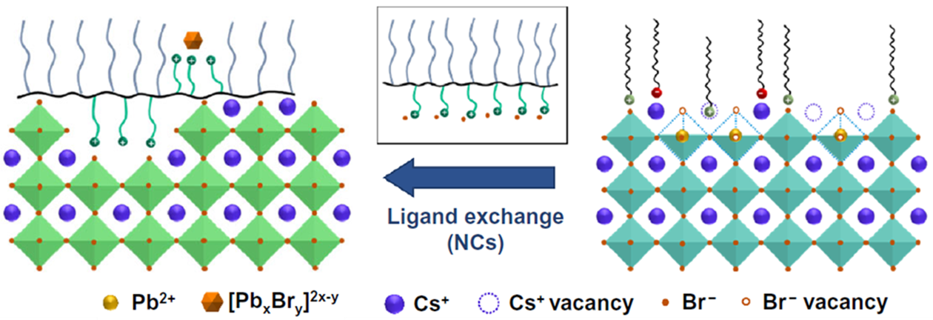
Surface Engineered Nanomaterials: Synthesis, Stabilization, and Applications Zunayed Mahmud Shuva¹, Jeff Procida¹, Unaisah Vorajee¹, Rajarshi Acharyya¹, Marissa Alcala,¹ Hedi Mattoussi¹
¹ Department of Chemistry and Biochemistry, Florida State University, Tallahassee, FL 32306-4390, USA.
Design
Applications
FRET Based Sensing
Application-specific nanomaterials with longer lifetime can be developed with the aid of interdisciplinary sciences. For that, exploring different synthetic methods and conditions is necessary. Moreover, designing the surface ligands with required functionalities is considered the key for stabilization and solubility as well as target binding and different applications.
Modification of surface ligands at surface of metal NPs and quantum dots (QDs) opens the door of numerous opportunities in terms of applications. Ligand stabilization can overcome challenges in perovskite QDs and LEDs , and organic reaction catalysis. Appropriate functionality allows for biological applications such as cell targeting and sensing, and so on.
QDs can be functionalized in such a way so that these are water-soluble QD and formation of QD bioconjugates on the surface bind specifically to target molecules and form stable conjugate complexes. Reported fluorescent resonance energy transfer (FRET) assays showed advantages in tuning the spectral overlap and configurations allowing a single QD donor to interact with multiple acceptors simultaneously.
Relation to Green Chemistry
Contrast Agents for ¹⁹F – MRI
Medical Diagnosis
The reaction to yield size- and shape-specific metal nanoparticles (NPs) bound with modified surface ligands requires a source of metal precursor (metal-native ligand complex), which can be prepared by greener techniques efficiently. Pastes of leaf, peel and other plant extracts can be good source of native ligands to synthesize the metal precursor.
Fluorine-19 based MRI (¹⁹F-MRI) has multiple reasons to be considered significant: the isotopes exhibit a high gyromagnetic ratio,100% natural abundance, very low traces of intrinsic fluorine in biological tissues (i.e. fluorine labeling allows easy visualization in vivo). Water solubility and enhancement of signals remain a challenge while designing a contrast agent for that.
Biocompatible coating via multicoordinating imidazole- and zwitterion-based ligands to QDs permits the introduction of reactive and biomolecular groups for further conjugation and targeting. These QDs can track pH changes and detect Fe ions and cysteine through charge-transfer interactions. Folic acid-functionalized ligands attached QDs could effectively target cancer cells.
Part 1: Preparing Native Coating Agents.
Part 2: Formation of the Precursor
Luminescent Nanocrystals
References
Improvement of perovskite nanocrystals (NCs) of cesium lead halides has gathered lots of interest. Passivation of surface vacancies and preservation of the nanocrystal integrity can be brought with halide based multidentate polymer coating. Additional complexation of the ligand with halide-based salt inhibits the damaging effects of etching, and imparted colloidal and morphological stability.
(1) Susumu et. al. “Enhancing the Stability and Biological Functionalities of Quantum Dots via Compact Multifunctional Ligands.” J. Am. Chem. Soc. 2007, 129 (45), 13987–13996. https://doi.org/10.1021/ja0749744.
(2) Akanda et. al. “Parameters Optimization of Fe3O4 NPs Synthesis by Tamarindus Indica Leaf Extract Possessing Both Peroxidase as Well as Excellent Dye Removal Activity.” Heliyon 2023, 9 (6), e16699. https://doi.org/10.1016/j.heliyon.2023.e16699.
(3) Nosratabad et. al. Molar Excess of Coordinating N-Heterocyclic Carbene Ligands Triggers Kinetic Digestion of Gold Nanocrystals. Dalton Trans. 2024, 53 (2), 467–483. https://doi.org/10.1039/D3DT02961A.
(4) Du et. al. “A Multifunctional Contrast Agent for19 F-Based Magnetic Resonance Imaging.” Bioconjug. Chem. 2022, 33 (5), 881–891. https://doi.org/10.1021/acs.bioconjchem.2c00116.
(5) Clapp et. al. “Fluorescence Resonance Energy Transfer Between Quantum Dot Donors and Dye-Labeled Protein Acceptors.” J. Am. Chem. Soc. 2004, 126 (1), 301–310. https://doi.org/10.1021/ja037088b.
(6) Vorajee et. al. “Engineering Highly Fluorescent and Colloidally Stable CsPbBr3 Nanocrystals of Different Shapes Using Imidazolium-Based Polysalt Ligands.” MRS Adv. 2023, 8 (7), 323–329. https://doi.org/10.1557/s43580-023-00556-8.
(7) Pons et. al. “Solution-Phase Single Quantum Dot Fluorescence Resonance Energy Transfer.” J. Am. Chem. Soc. 2006, 128 (47), 15324–15331. https://doi.org/10.1021/ja0657253.
(8) Wang et. al. “A Multifunctional Polymer Combining the Imidazole and Zwitterion Motifs as a Biocompatible Compact Coating for Quantum Dots.” J. Am. Chem. Soc. 2015, 137 (44), 14158–14172. https://doi.org/10.1021/jacs.5b08915.
Synthesis
The top-down core digestion method involves the application-specific engineered ligands kicking out the native ligands, followed by reaction parameters (i.e. time, temperature and ligand concentration) dependent surface etching via kinetic dislodging of surface atoms and formation of Metal-ligand complex progressively.
https://x.com/MattoussiGroup
The Mattoussi Lab
https://www.chem.fsu.edu/~mattoussi/

